Slide 1
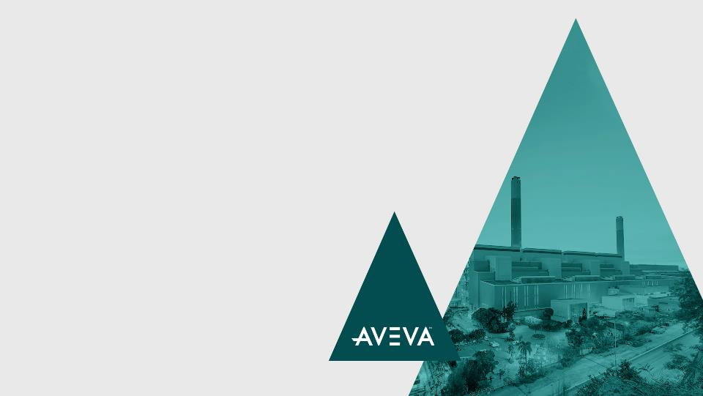

Success Stories
Across Key Industries
This is what customer success stories are all about: sharing innovative examples of how companies are performing their work better, faster, less expensively and greener on the fast track to achieving operational excellence, with a little help from AVEVA.
Confidential Property of AVEVA

Slide 2












AVEVA Success Stories Across Key Industries
Select an industry to begin viewing success stories
Chemicals
Food & Beverage / CPG
Hybrid / General Manufacturing
Infrastructure
Life Sciences
Machine Builders / OEM
Metals, Minerals and Mining
Oil and Gas
Power and Utilities
Water and Wastewater
Marine
EPC
© 2018 AVEVA Group plc and its subsidiaries. All rights reserved.

Slide 3

Chemicals
3

Slide 4
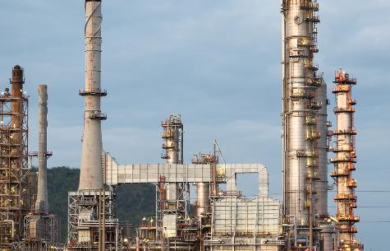
Ascend Performance Materials
  Pensacola, Florida
Goals
    Eliminate manual input of data
    Visualize the overall manufacturing process
    Accurately record all relevant manufacturing data
Challenges
    The business was not tracking data to ensure production efficiency and product quality
    There was a lack of process consistency throughout the plants
Results
    The company achieved a savings of $500,000 in utilities and
    materials costs
    More than $1 million in savings was achieved in maintenance costs
    Avoided potential plant shutdowns which equates to a savings
    of $2 million
    Overall technology implementation took only 90 days
Industry: Chemicals
Products: Mobile Operator Rounds | Intelligence | Workflow Management
  “We’ve found a great benefit in being able to maintain a core user group and consistency throughout the plants.”
Terry Unruh, PE Production and Maintenance, Ascend Performance Materials
LEARN MORE

Slide 5
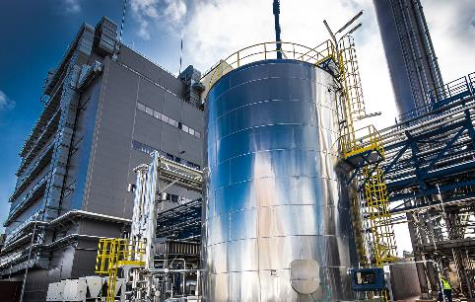
Azoty Tarnow S.A
  Poland
Goals
    Increase the production effectiveness, traceability and safety by installing a central control and monitoring system
Challenges
    Very high maintenance costs (energy, methane consumption)
Results
    Manufacturing costs has been reduced as a result of the new
    Monitoring System
    Access to key media parameters analysis (quality, consumption)
    in real-time resulted in more efficient manufacturing
    Improved information flow (delivering actual data to technology engineers) has been achieved.
Industry: Chemicals
Products: Mobile Operator Rounds | Process Historian | Process Historian Client
InTouch HMI (Standard Edition)
“Using the latest technology and IT solutions to build a telemetry and monitoring system shows that Azoty Tarnów is a modern company that is concerned about high quality and low production costs. This is reflected in the competitiveness of our products, the desire to have a safe workplace and a company that is concerned about the environment.”
Lucjan Knapczyk, Technology Specialist at Automatyka Sp. Z.O.O
LEARN MORE

Slide 6
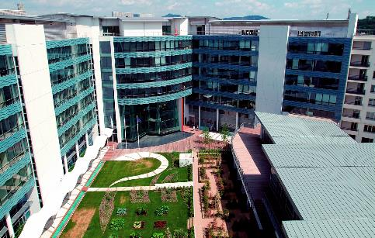
Bayer CropScience AG
  France
Goals
    Increase the treatment capacity of the Biology department
    Reduce biologists’ contact with the treated plants
    Implement a new organization within 18 months
    Provide operators with tools that are easy to use
Challenges
    Referral agent partners for each business are involved in the project
    Bayer/SITAM work group - a commitment for the success of the project
    An open software environment
Results
    Complied with all priorities and deadlines for implementing and deploying the solution
    Cost of the solution was controlled thanks to the stringency of the SITAM management processes
    Quick familiarization with the system
    Control and transparency of the information which enabled
    successful collaboration
Industry: Chemicals
Products: Process Historian Clients, InTouch HMI (Standard Edition),
Process Historian
“The AVEVA solution provided the plant with reliable production, increased safety and improved product quality. As a result of the implementation, the Dorogobuzh plant far exceeded its NPK production targets.”
  Vadim Kovtunenko, Strategic Direct Sales Executive AVEVA
LEARN MORE

Slide 7
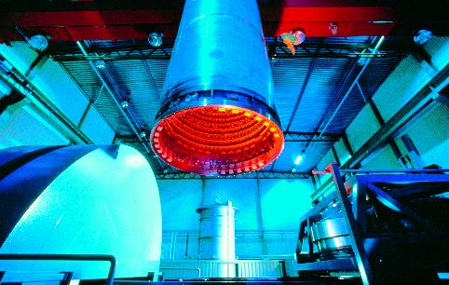
Bodycote Hot Isostatic Pressing Plant
  London, Ohio
Goals
    Improve control and consistency of furnace temperatures
    Enact a proactive maintenance program to save equipment costs
    Provide better tools to increase operator efficiency and accuracy
    Reduce product re-runs
Challenges
    Existing data system did not provide historical information or useful reports
    Uniformity of temperatures difficult to control between furnace
    units of different sizes
    Maintenance scheduling based on calendar dates, not run times
    or performance data
Results
    Proactive maintenance program enabled steady productivity and better planning of capital expenditures
    Recipes have increased run-over-run product consistency and customer satisfaction
    Operator efficiency improved; fewer operators accomplish more work
    with better accuracy
    Reports provide more visibility and help facilitate better decision making
Industry: Chemicals
Products: Process Historian Clients, InTouch HMI (Standard Edition),
SCADA Alarm Software, System Platform
“Since getting System Platform, we’ve noticed a decrease in product run-wrongs and parts that need re-processing.”
Shawn Crawford, Plant Engineer
LEARN MORE

Slide 8
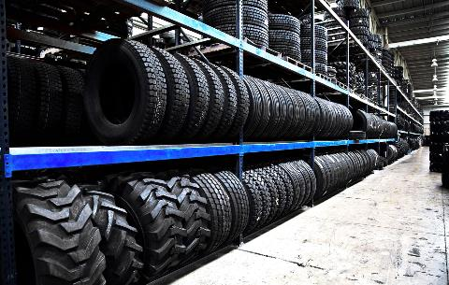
Brisa Bridgestone Sabanci Lastik
  Istanbul, Turkey
Goals
    Create a flexible and user friendly solution that will measure the performance of the machines used in manufacturing
    Ensure the effectiveness and efficiency of the
    production processes
Challenges
    Make sure that the solution will allow that operators perform the work
    in the right time and order
Results
    The new Manufacturing Execution System allows for the measurement of performance
    Plant management can accurately measure and analyze all
    production information
    Best manufacturing decisions being taken
Industry: Chemicals
Products: InTouch HMI (Standard Edition), Operations, Performance
“Thanks to AVEVA solutions, we are able to monitor performance better and we are assured that the right products are being manufactured. This enables us to conduct accurate analyses and make the right decisions.”
Mustafa Tacettin, Factory Automation Systems Mgr. Brisa Bridgestone Sabanci Lastik
LEARN MORE

Slide 9
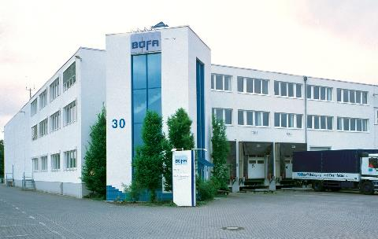
BÜFA Reinigungssysteme GmbH Co. Ltd. Oldenberg, Germany
Goals
    Preservation of normally high availability
    Expansion of Manufacturing Execution System functionalities in interaction with Microsoft Dynamics NAV (ERP software)
    Optimization of the visualization system
    New software architecture, consisting of individual Manufacturing Execution System, batch and HMI/SCADA functions
Challenges
    System modernization (network and PC components)
    Fault-free system transition with no impact on production
    Higher flexibility in recipe production
    Replacement of existing visualization through a full-featured HMI client
Results
    Fault-free transition to a new batching and recipe management system that involves the manufacture of 500 different products
    Largely improved visibility through enterprise-wide MES
Industry: Chemicals
Products: Batch Management, InTouch HMI (Standard Edition),
Device Integration Server
“We transitioned smoothly to the new system based on a proven and successful solution for the modernization and expansion of our recipe management.”
Jörn von Wieding, CEO of BÜFA
LEARN MORE

Slide 10
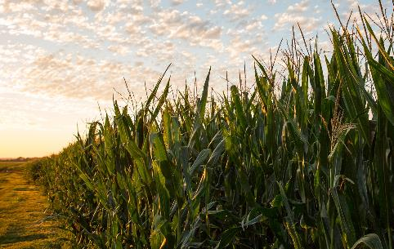
CF Industries
  United States
Goals
  Locate software to deliver continue maintenance planning functionality while providing the flexibility for growth and costs savings
Challenge
  The investment to keep homegrown application in pace with growing business is expensive (well over $1 million)
Results
    Approximate cost savings of $2 million through improved sourcing and contract negotiations
    Reduced inventory management and purchasing costs by several million dollars
    This system automates maintenance planning and tracking activities on nearly 50,000 asset entities and 60,000 items in the four manufacturing locations
Industry: Chemicals
Products: InTouch HMI (Standard Edition)
“We’ve installed the AVEVA solution and it paid for itself almost immediately. It turns raw data into business intelligence and that improves our performance.”
  Dave Wiedenfeld, Group Project Leader, IT
LEARN MORE

Slide 11

Cray Valley
  Spain
Goals
    Cray Valley’s key objective was to update the control and monitoring of its three alkyd resin production manufacturing lines, replacing aging PLC and SCADA systems with current technology
Challenges
    Deployment of the new software infrastructure needed to be quick
    and seamless to minimize the impact on plant production cycles and
    delivery schedules
    The semiautomatic production infrastructure required precise programming of the command objects to ensure correct management of all plant operations
Results
    Access to production data has been greatly improved, as well as integration of plant and control hardware connectivity
    The System Platform infrastructure fully supports future expansion by accommodating new production functions and product requirements
    The engineering team can more easily revise and implement new production settings as needed to maintain manufacturing schedules
Industry: Chemicals
Products: InTouch HMI (Standard Edition)
“Cray Valley has achieved a rapid and straightforward migration of its automation infrastructure with System Platform, enabling the company to scale manufacturing operations to meet future market demands.”
  Xavier Pujol, Head of Engineering
LEARN MORE

Slide 12

Imperator
France
Goals
    Automate the batch production lines for lubricating greases in order
    to limit the influence of human factors
    Obtain improved regularity in the quality of the grease produced
    Increase the production Infrastructure’ efficiency and avoid losses of production lots
    Develop a tool that enables Imperator personnel to develop and execute themselves their new formulations, without using the integrator
Challenges
    Adapt to the constraints of the company, which has a weak culture in automated operations and industrial data processing
    Develop a solution that makes it possible to apply the same formulation
    on different production lines
Results
    Fewer variations in the quality of the greases produced
    Production Infrastructure optimized with 16,000 metric tons produced
    every year
    Dialogue facilitated between the formulator and the “machine” technicians using the same man-machine interface
Industry: Chemicals
Products: System Platform, Process Historian, Batch Management,
InTouch HMI (Standard Edition)
“We have a huge project to automate our 10 batch production lines for lubricating greases. Batch Management gives us the open technical standard, in compliance with standard S88, that we were looking for.”
Vincent Duthoit, Imperator’s Manufacturing Manager
LEARN MORE

Slide 13
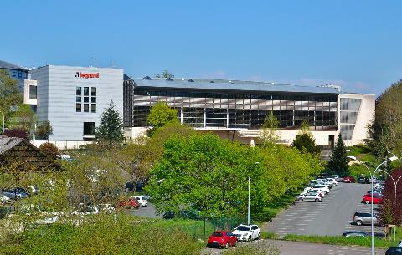
Legrand
France
France
Goals
    Revamping the supervision of a powders’ production unit for the manufacturing
    of cable trays
    Simplifying the use of the control station by keeping manual data entry to a minimum
    Editing production reports and making them easily accessible
    Being able to carry out operations on the supervision application in the event of minor modifications being required
Challenges
    Assimilating the software tools in order to work efficiently with the integrator
    Scrutinizing the existing supervision application and adding new functions, considering requests formulated by all departments concerned in the factory
    Meeting very short implementation deadlines
    Providing secure operation in the event of the ‘loss’ of a supervision station
Results
    The recipes are centralized on a single server and are easy to update
    Production reports highlight process malfunctions and envisage process upgrades
    Eliminated the need to call the integrator for modifications to the supervision application
Industry: Chemicals
Products: Operations, Process Historian Client, InTouch HMI (Standard Edition), System Platform
“In the framework of the revamping of our control/command installation, InTouch HMI was the obvious choice because it had been used successfully on other Legrand sites. We wanted to push the envelope further and adopted System Platform.”
Michel Gatinois, Responsable du bureau d’études ‘process extrusion,’ Legrand
LEARN MORE

Slide 14
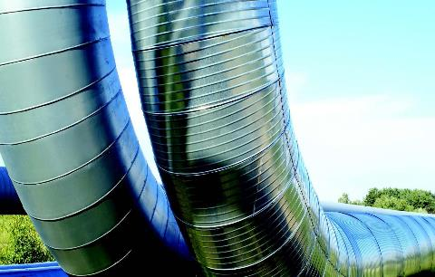
PG Monitoring System AB
Sweden
Goals
    To increase safety using a more effective warning system to prevent leaks by detecting decomposition at an early stage
    To streamline the implementation phase for new projects
Challenges
    Geographically dispersed PLCs and continuous development of Stockholm’s district heating network require a high degree of flexibility and a comprehensive overview
    With approximately 10,000 I/Os, a system is required which provides operations personnel with information that is updated in real time
Results
    Thanks to a greater degree of insight, leaks are avoided which would otherwise have cost anywhere between five thousand and several
    million euros
    The AVEVA scalable software solution mean that it only takes a few days to develop and configure the monitoring system in a new geographical area by reusing modules that communicate with
    the PLC units
    An improved overview and a wireless Geo SCADA system warn operations personnel of potential leaks within a minute rather than
    them performing manual checks a few times a year
Industry: Chemicals
Products: System Platform, InTouch HMI (Standard Edition)
“To begin with the new system was viewed as a way of cutting back on staff, but instead it has helped create a totally new way of thinking at most energy companies. By preventing problems and working with the maintenance of the pipes, they can detect and repair problems they never knew existed.”
Håkan Klarin, CEO, PG Monitoring System AB
LEARN MORE

Slide 15
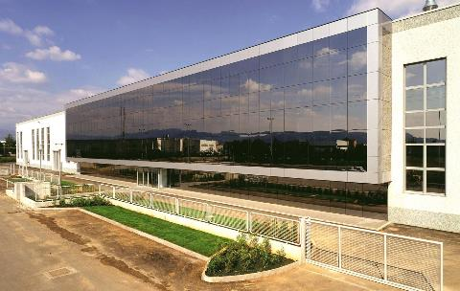
ST Powder Coatings S.p.A.
Montecchio maggiore (VIC), Italy
Goals
    To enable the company to ramp up and begin fulfilling
    orders within 4 months
    Keeping production efficiency and product quality consistently high
Challenges
    To get the plant up and running as quickly as possible
    Very short development time available
Results
    Remain consistently competitive by quickly delivering the
    highest-quality thermosetting powders based on complex
    customer requirements
    Software‘s integration attributes enable him to focus on his core competency: getting the most out of the factory
Industry: Chemicals
Products: InTouch HMI (Standard Edition), Process Historian, Process Historian Clients
“Using AVEVA, we've increased our productivity by 30%.”
  Massimiliano Nicoli, Plant Manager for ST Powder Coatings
LEARN MORE

Slide 16
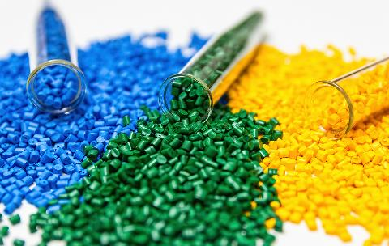
PVC Compounders
Texas, USA
Goals
    Ensure that the recipe for each compound is accurate and consistent
    Easy access of plant operators to compound formulations
    Increase plant productivity but still maintain high product quality
Challenges
    All products are built to order and inventory is always at a minimum
    Plants from different states need to communicate and pass information
    Extreme temperature fluctuations at plant site
    Language problems with local labor force
Results
    Less than 1% internal failure
    Reduction in downtime by 15-20%
Industry: Chemicals
Products: Process Historian Clients, InTouch HMI, System Platform
With AVEVA in place, our internal failures have really reduced. Our goal for internal failures is less than 1%, and we’ve been meeting these goals.
Subburaman Ananthanarayanan, Quality Manager
LEARN MORE

Slide 17
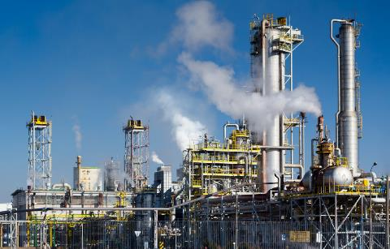
NIIK
Dzerzhinsk, Russia
Goals
    Improve plant safety.
    Instill greater confidence in the operator.
    Unite the company in their approach to implementing change.
    Challenges
    Improve change management across departments.
    Grow visibility of processes at the design supervision stage.
    Results
    Working relationships are improved.
    Updates are communicated automatically instead of tracked manually.
    Progress is easily monitored and controlled at all stages of design and construction.
Industry: Chemicals
Products: AVEVA Everything 3D (AVEVA E3D), AVEVA Bocad, AVEVA Engineering, AVEVA Diagrams, AVEVA Instrumentation, AVEVA Electrical
“IT investments are literally investments in the future. That’s how we approach this line in the budget.”
Oleg Kostin, Managing Director, NIIK
LEARN MORE

Slide 18

Infrastructure
18

Slide 19
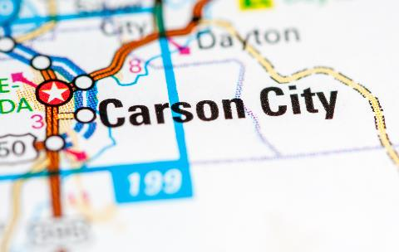
Carson City
  Nevada
Goals
    Efficiently manage the City’s water, wastewater, transportation, landfill, fleet, environmental and renewable power systems around the clock
    Leverage the latest virtualization technologies, including iPads and smart phones, to increase the efficiency of operators and management,
    as well as increase situational awareness to achieve a high level
    of operational readiness
Challenges
    Deliver affordable and reliable transportation, power, water, and wastewater services to citizens and visitors to Carson City and surrounding counties
    Reduce administration and overhead costs while significantly increasing the City’s operations reliability and disaster recovery processes
Results
    Remote management capabilities have resulted in 15% reduction in operations staff hours due to saved “drive time”
    Reduced work week from five eight-hour days to four ten-hour days
    Helps manage the city’s solar plants that provide up to 748,000 KWH of clean power each year
    Delivers more than 22 million gallons of water while processing 6.9 millions of gallons of wastewater each day
Industry: Infrastructure
Products: System Platform, InTouch HMI, Process Historian, Process Historian Clien, Development Toolkits
“Remote management capabilities have resulted in 15% reduction in operations staff hours due to saved 'drive time.”
  James Jacklett, Electrical/Signal Supervisor, Carson City Public Works
LEARN MORE

Slide 20

China Ministry of Railways
  Shanghai, China
Goals
    The new system required quick implementation, effective integration with current equipment and a user-friendly operator interface
    An easy and efficient upgrade path was imperative for planned
    future expansion
Challenges
    The initial project had to be completed in time for the August 2008 Olympic games in Beijing
    The 100-mile line was the first high-speed railway to be built in China
Results
    Operational costs were immediately reduced because personnel could be allocated more effectively
    The new system saves energy since actual demand determines equipment usage levels
    Better visibility to the entire system has led to decreased
    maintenance costs
    New stations can be deployed as needed and configured
    in as little as one day
Industry: Infrastructure
Products: System Platform, InTouch HMI, Process Historian, Process Historian Client, Development Toolkits
“We are collaborating with 60 different vendors for each station’s Passenger Information System. Every vendor can communicate seamlessly with each other because of the System Platform. This allows us to quickly and easily respond to our
customer’s requirements.”
  Shao Xiaofeng, Vice President, Easyway Company Limited
LEARN MORE

Slide 21
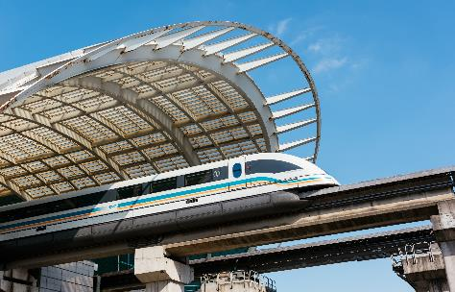
China Ministry of Railways
  Beijing, China
Goals
    The nationwide high-speed railway network required quick implementation, effective integration with third-party components
    and a user-friendly operator interface
Challenges
    The company had to quickly duplicate systems, processes and functions implemented at major passenger stations for smaller stations throughout the rail network
Results
    The AVEVA solution allowed the integration of 60 different third-party vendors into the station’s Passenger Information System.
    New stations can be deployed as needed and configured
    in as little as one day
    Operational costs have been lowered because personnel can be reduced or allocated more effectively
    Better visibility to the entire system has led to decreased
    maintenance costs
Industry: Infrastructure
Products: System Platform, InTouch HMI, Process Historian, Process Historian Client, Development Toolkits
“We are collaborating with 60 different vendors for each station’s Passenger Information System. Every vendor can communicate seamlessly with each other because of the System Platform. This allows us to quickly and easily respond to our customer’s requirements.”
  Shao Xiaofeng, Vice President Easyway Company Limited
LEARN MORE

Slide 22

City of Barcelona
  Spain
Goals
    To achieve a more sustainable and livable city by improving the
    quality of life of its citizens
    To ensure that all available resources function and are optimized efficiently
Challenges
    A solution was needed to enhance the availability and functionality
    of the city’s resources such as elevators, escalators, public fountains,
    parks and gardens
    More effectively manage the city’s water consumption for both irrigation
    and public use
    Implement a scalable system that enables the integration of new
    city processes and facilities
Results
    The city has optimized water consumption via a communications infrastructure built upon the existing irrigation network via a customized SCADA system
    Wonderware System Platform provides a modular structure composed of standardized communication equipment and protocols ensuring connectivity between existing and future systems, as well as scalability to adapt to the needs of the city
    The open platform allows seamless management in real-time of tailored-made applications via a centralized control system"
Industry: Infrastructure
Products: System Platform, InTouch HMI (Standard Edition)
“The implementation of smart systems operating Wonderware System Platform enables us to improve the management of various municiple activities deployed throughout the city to achieve a more sustainable city.”
Cristina Vila Rutllant, General Manager, Barcilona de l’Aigua SA, Barcelona City Council
LEARN MORE

Slide 23
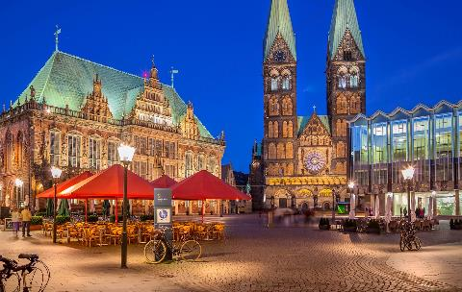
City of Bremen, Germany
  Bremen, Germany
Goals
    Unify more than 1,200 municipal properties under a single, open building management system (BMS)
    Optimize the efficiency of heating systems in the buildings to cut
    energy consumption
Challenges
    The buildings were running proprietary BMS from several different vendors
    The properties were managed at six control Infrastructure located around the city under the direction of five geographical districts and regional supervisors
Results
    An open BMS based on the AVEVA solution is in place, centralizing the management of the extensive property list (160 Infrastructure in all)
    Regional supervisors all now have access to the BMS
    Energy consumption is down by 15% to 18%
    Assumed cost saving of more than € 30,000 (US$ 43,000) per year
    Adding buildings to the system is simple and more efficient due to the extensibility of the AVEVA
Industry: Infrastructure
Products: System Platform, InTouch HMI (Standard Edition), Process Historian, Process Historian Client, Development Toolkits
“As our regional supervisors can now access all heating systems from a central location, they will be able to successively optimize the systems one by one.”
Rüdiger Heinenbruch, Technical Operations Manager, Immobilien Bremen
LEARN MORE

Slide 24

Ciudad Agroalimentaria of Tudela
Spain
Goals
    Monitor and control the motors, boilers, compressors and electrical system
    that make up the General Infrastructure Centre of the
    Ciudad Agroalimentaria of Tudela
    Monitor and control the regulating stations and monitor user consumption.
Challenges
    Gain integral control with totally visible energy generation of conventional systems as well as auxiliary ones
    Respond to environmental requirements set by Spanish legislation
    for this type of installation
    Build a scalable system that allows necessary expansions of the system as new users are installed
Results
    A guarantee is given to users at the Ciudad Agroalimentaria of Tudela,
    for a more efficient energy distribution that will significantly reduce
    costs of operations
    Complete control of thermal and refrigerated equipment infrastructure
    as well as auxiliary services - gas, compressed air, electrical network,
    - depending on the different typologies of the users
    Possibility of improving the infrastructure’s control to cater to future growth as more companies join the Ciudad Agroalimentaria of Tudela
Industry: Infrastructure
Products: System Platform, Process Historian Client,
InTouch HMI (Standard Edition)
“Wonderware enables access to the information related to our energy consumption in a completely flexible way. In an installation like this, the correct automation and limitation of variables is a key aspect for guaranteeing the quality of production and compliance with
environmental regulations.”
Luis Monzón, Operations Manager, Ciudad Agroalimentaria of Tudela
LEARN MORE

Slide 25

Echelon Corporation
  California, USA
Goals
    Enable Echelon to benefit from the energy management, control and cost savings that the technology provides
    Contribute to the San Jose, California community by conserving power and participating in local demand response programs
Challenges
    Echelon needed to design on an open platform that would enable products from many different suppliers to work together
    Find a solution that could bring software and development costs to an affordable level that would be justifiable for varying sizes of customers and Infrastructure
Results
    Echelon’s headquarters uses 40% less energy than comparable buildings in the area
    Corporation saves approximately $30,000 yearly by participating in San Jose’s demand response programs
    Using the Wonderware software solution, Echelon has built a compelling demonstration model for prospects, customers, the press and analysts
Industry: Infrastructure
Products: Process Historian Client, InTouch HMI (Standard Edition), System Platform
“Wonderware makes system design much easier and saves both time
and money for our customers.”
Steve Nguyen, Director of Corporate Marketing
LEARN MORE

Slide 26

Ecocity Valdespartera Zaragoa
Spain
Goals
    To implement an integrated remote-control monitoring system for the city’s urban services including drinking water supply network, sewage and rainwater treatment, landscape watering systems, electricity and gas supplies, street lighting, and pneumatic waste collection
Challenges
    A need existed to integrate and consolidate data from a multitude of instrumentation devices that are responsible for operating the infrastructure as the first type of city of its kind, Valdespartera required constant monitoring and evaluation of municipal services to ensure they met the sustainability goals of the overall urban design plan defining a common data capture infrastructure to measure and transmit information to a unified control center that would supervise compliance with the environmental criteria
Results
    The automation system manages 196 control points from nine service networks which comprise the city’s technical infrastructure, ensuring compliance with environmental initiatives
    The system’s 78 servers/cabinets gather and store information received from 21,483 communication signals relayed from 9,000 digital meters installed throughout the city collected data is automatically distributed to technical management personnel, as well as a database where it is stored as “public interest” knowledge for future analysis on urban energy efficiency
Industry: Infrastructure
Products: Process Historian Client, InTouch HMI (Standard Edition), System Platform
“By powering the city’s remote monitoring and management system, Wonderware software addresses two key issues for the Valdespartera team: effective and efficient control and management of all municipal networks, as well as accessibility and analyzing of environmental impact of operations in an integrated manner.”
Noelia Olona, Technical Area Manager
LEARN MORE

Slide 27
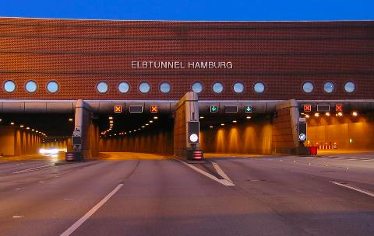
Elbe Tunnel
Hamburg, Germany
Goals
    Monitor and control traffic through the underwater tunnel, which averages 142,000 vehicles per day
    Regulate tunnel ventilation, lighting, safety and emergency systems
Challenges
    The four-tunnel system includes approximately 850 control points
    The tunnel is over 34 years old, and continual updates are required to keep the project modernized
Results
    An open, highly scalable system featuring Wonderware software has enabled easy integration of technology additions and upgrades
    Expansion of the Infrastructure management system has become more cost effective and time efficient
Industry: Infrastructure
Products: InTouch HMI (Standard Edition)
“By using upward-compatible, standard software from Wonderware, we were able – even in the first phase in 1996 – to lay the foundations for later expansions. There has never been a need for an expensive, time-consuming renewal of the InTouch application for version upgrades.”
Olaf Kolmer, Project Manager, Cegelec AT GmbH
LEARN MORE

Slide 28
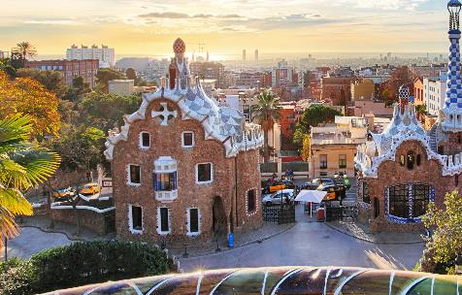
Ferrocarrils de la Generalitat de Rubí (Barcelona), Spain
Goals
    To deploy a supervisory control system for a railway system in Spain that involves the remote control of rail station operation (ticket sales, opening and closing of doors, lighting, etc) that is able to meet the high standards of excellence and reliability required by the company
    To integrate existing automated processes in order to obtain the most out of previous technological investments
Challenges
    To maintain a high level of customer support by improving service despite an increase in processes in the network being controlled.
    To integrate multiple units of servers and owner PLCs into a single supervisory environment with a common interface for all processes.
    To complete the deployment of the new supervisory system without halting plant services and to ensure the smooth functioning of the countless remote- controlled operations at each station: ticket vending machines, escalators, access control, etc.
Results
    Improved customer satisfaction by providing seamless service, a strong policy for preventing incidents and better response times for passengers
    Management of the remote-controlled operations by professionals in the control centre is carried out in a simple, fully automated manner and with
    total process reliability
Industry: Infrastructure
Products: Process Historian Client, InTouch HMI (Standard Edition), System Platform
“The challenge we have set ourselves as a company is that of excellence in customer service. Trains have to be punctual, stations must be kept clean and fully operational and any complaints or suggestions should be addressed and resolved. Each year, we seek to achieve higher satisfaction levels from our users and Wonderware technology is an essential tool in achieving this.”
Alicia Coca,Head of the Systems Development Department at
Ferrocarrils de la Generalitat de Catalunya
LEARN MORE

Slide 29
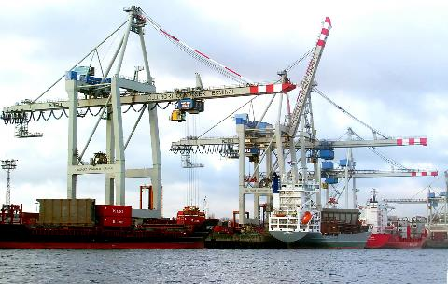
Hamburger Hafen und Logistik AG
  Hamburg, Germany
Goals
    Hamburger Hafen und Logistik AG (HHLA) needed to double its container capacity at its Burchardkai container terminal
    The company required an automation process that could accommodate a new warehousing business objective of increasing container stacking capabilities from three to five stories
Challenges
    With shipments arriving 24/7, HHLA operators were tasked with managing control processes and monitoring the technical operational devices at the Burchardkai container terminal on an aggressive, non-stop time schedule
Results
    With the implementation of standards, HHLA can easily make modifications to the entire system regardless of vendor-specific hardware or software
    The integrated modularity of the solution provides extensive
    scalability which enables HHLA to expand and enhance the control system to achieve its Goals of doubling the capacity of its container management business
    The solution offers flexibility that enables HHLA to duplicate the control system at its other container terminals in the future
Industry: Infrastructure
Products: InTouch HMI (Standard Edition), InTouch HMI (Standard Edition) for Terminal Services, System Platform
“The object-oriented approach of the AVEVA is very beneficial in the central development environment. The hierarchical structure of the shared system areas is centrally stored for easy access and maintenance.”
Rudiger Friedrichs, Project Manager, Industrial Systems Cegelec
LEARN MORE

Slide 30

L’hopital New Orleans
France
Goals
    To establish a business management system (BMS) that provides comprehensive control of the hospital’s infrastructure operations
    To allow optimal functioning of technical installations and enable
    fault detection with alarming capabilities
    To successfully meet environmental requirements
    To reduce the hospital’s operational and management costs
    Challenges
    Guaranteeing a maximum response time of five seconds at any
    point of the site
    Enabling all hospital equipment to communicate via a multiprotocol solution
    Creating an ergonomic solution which is easy to use
    Results
    Information is now available in real-time with the ability to manage approximately 1,500 hospital alarm points and 10,000 technical points
    The optimization of energy and maintenance operations have resulted in reduced costs
    Availability of traceable information and reporting enables for more
    efficient management of the system’s 80,000 data points
    Improved response time enables staff to address incidents within
    a 5 second window
Industry: Infastructure
Products: System Platform, Wonderware InTouch for Terminal Services, Process Historian
“With Wonderware System Platform, we now have a detailed log of all recorded data.
This enables us to perform a quick analysis and guarantees traceability and optimal response times.”
Philippe Chapuis, Engineer,
Maintenance and Operations Manager, New Hospital of Orléans
LEARN MORE

Slide 31
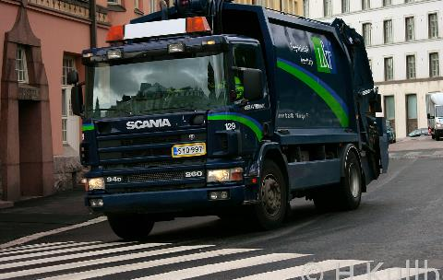
Lassila and Tikanoja
Finland
Goals
    Enable efficient work cycles and arrange timing of auxiliary and maintenance work so less production time is spent on these issues
    Seamless connection with existing corporate software and automation equipment from various manufacturers
Challenges
    Existing equipment and software from different manufacturers is part of production line
    Efficiently collect and convert plant-level data into usable information
Results
    Plant has achieved a 20% increase in operating time
Industry: Infrastructure
Products: System Platform, Process Historian, Process Historian Client
“The Wonderware solution has helped in finding and eliminating the issues which slow down production. It has improved the operating time of the plant by approximately 20% as well as handles the production and work time management of the plant. I believe that many more benefits are still to come.”
Simo Vihavainen, Maintenance Manager, Lassila and Tikanoja, plc.
LEARN MORE

Slide 32

Museumsinsel Berlin
  Berlin, Germany
Goals
    Standardization of all control systems so that personnel could be assigned to any building without additional technical training
    Officials wanted to establish central control of Infrastructure management systems for all buildings to enable maximum asset performance and cost control, as well as support plans for system enhancements and museum expansion
Challenges
    Systems managers had to use the museum’s existing IT infrastructure
    which required the implementation of an open-architecture design
    Because of a revolving staff assignment structure, the system needed
    to be very easy to use with minimal user training
Results
    The AVEVA solution successfully linked all of the museum’s Infrastructure using a standardized control and management technology, with a common, simplified user interface
    The transmission of data is now conducted in real-time, enabling staff
    to immediately address potential issues within the system
Industry: Infrastructure
Products: InTouch HMI (Standard Edition), Process Historian,
Process Historian Client
We selected a combination of AVEVA designed to specifically address our need to manage the various building automation systems throughout the museum complex.”
Erik Zimmer, Administrator of GLT/MSR Technology
LEARN MORE

Slide 33
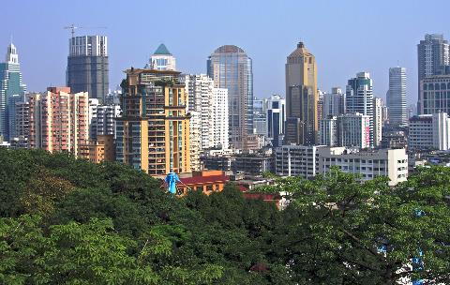
Nanjing Metro
Nanjing, China
Goals
    Construct and operate a safe and efficient metro system
    for the city of Nanjing
    Provide a comfortable travel experience while
    reducing energy consumption
Challenges
    Nanjing is a large city with only one other metro line
    The new solution must manage 24 stations as well as a control center, repair depot and other supporting Infrastructure
Results
    The Wonderware solution forms the foundation for the new train line which serves over five million citizens of Nanjing
    Development and implementation of the line has been efficient and the scalability of the Wonderware software will ensure that planned expansion will be efficient
Industry: Infrastructure
Products: Process Historian Client, InTouch HMI (Standard Edition),
System Platform
“The Wonderware solution) has significantly increased efficiency, reduced our error rate, made it easy for us to add functions and has allow us to maintenance the system at a much lower cost. It will definitely help us as we continually expand.”
Niu weixing, Project Engineer
LEARN MORE

Slide 34
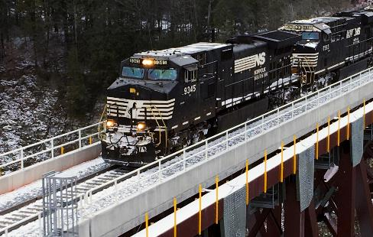
Norfolk Southern Railway
Norfolk, Virginia, U.S.A
Goals
    Operate more than 21,500 route miles in 22 states
    and Ontario, Canada
    Completely automate the operation of the trainyard
    Decrease labor cost and replaces old and antiquated equipment
Challenges
    Receive up to 2,000 train cars in any given day while assuring efficiency and safety
    Provide critical information using devices that are easily accessible by trainyard personnel
Results
    Using the InTouch package, the development time for the HMI was reduced to 40 to 50 percent
    The new software has increased the work efficiency of both the yardmasters and the trainmasters at Buckeye trainyard
Industry: Infrastructure
Products: InTouch HMI, Industrial Computers
“The new Wonderware system has definitely decreased the labor costs involved with the repair and upkeep of the system on a day-today basis. We’ve been able to remove a lot of old and antiquated equipment we no longer need due to the upgrades in the current software.”
Tim Forman, Trainmaster Norfolk, Southern Railway
LEARN MORE

Slide 35

Palace of Versailles
France
Goals
    To enable diverse and distributed technical equipment to communicate through an open system which can interface with the different processes
    To deploy the Hypervision solution to help minimize impact on the historical site and with no interruption to its operation
Challenges
    The site was operating a disparate collection of hardware and software that was not integrated, preventing staff to view real-time operations
    There was an enormous collection of data stored in various formats that was not centralized or optimized for effective use
    The system was not scalable
Results
    Response times for addressing maintenance issues significantly shortened
    System and data integration was greatly improved, while decreasing system development costs
    Implementation of real-time data communication and hot server redundancy greatly enhanced the management team’s success
    Access to trackable data and reporting capabilities enable the team to improve a variety of site operations, including energy use
Industry: Infrastructure
Products: System Platform, Process Historian, InTouch HMI (Standard Edition)
“Wonderware software solutions were key to our team’s success in achieving the project’s three main objectives - historical restoration of the property; the modernization of management processes, enhancement of the technical networks; and improvement of the visitor’s experience.”
Tim Forman, Trainmaster Norfolk, Southern Railway
LEARN MORE

Slide 36
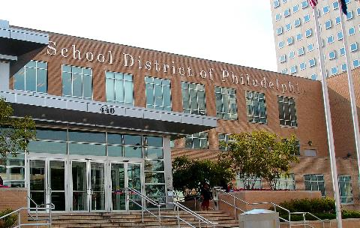
Philadelphia School District
  Philadelphia, United States
Goals
    To get a 50 percent increase in the number of work order tasks to be accomplished in Infrastructure maintenance
    Manage the entire work order process, including scheduling
    and materials availability
    Better way to track staff activities, spare parts inventories,
    and work orders
Challenges
    Upgrade aging system, reduce operation costs and increase service levels
    with a greater accountability for a $100 million annual capital budget
Results
    Doubled productivity from 50,000 to 100,000 tasks a year
    Reduced average cost of completing a task down from $627 to $400
    Expected savings to be almost $10 million in the first year
    Improved average operational cost of $5.53 a foot, compared to other government Infrastructure cost of $5.91 per square foot
    Increased ability to monitor parts inventories and purchasing activities
    so mechanics no longer have to wait for parts
Industry: Infrastructure
Products: InTouch HMI (Standard Edition)
“We are one of the first school districts anywhere, especially of this size, to take on a computerized management maintenance system package with the power of AVEVA.”
Tom McGlinchy , Chief Operating Officer
LEARN MORE

Slide 37

Port of Portland
  Portland, United States
Goals
    Move cargo expeditiously to provide cargo-handling services that enhance customers productivity in distributing goods
    Provide high-quality service with great cost efficiency in order to maximize the business benefit to the Port of Portland
Challenges
    Locate a single system that can handle the marine Infrastructure and equipment maintenance department’s immediate needs and add dredging operations management and aviation Infrastructure maintenance at Portland International Airport (PDX) in the future.
Results
    Streamlined operations to continue to move more than 30 million tons
    of cargo through port Infrastructure every year
    Reducing inventory in both the electric shop and the equipment shop
    by at least 65%
    Improved tracking: port departments can now monitor the time it takes
    for someone to go out and do a maintenance or repair job
    PM changes have saved a quarter of a million dollars in the first year
Industry: Infrastructure
Products: InTouch HMI (Standard Edition)
“Using a powerful toolset like the AVEVA solution, we now have the ability to manage infrastructure maintenance in such a way that we’re making the best use of our physical assets.”
Robert Maracle, General Superintendent of Marine Equipment Maintenance
LEARN MORE

Slide 38

SALT – Società Autostrada Ligure Toscana p.a. Italy
Goals
    Improve safety, reduce energy and maintenance costs of the AI2 Motorway
    Obtain real-time information about status and alarm conditions of toll
    gate and tunnel equipment
    Enable the automatic control and operation of tunnel lighting and
    ventilation systems
Challenges
    Manage a critical infrastructure with 24 tunnels and 75 km classified
    as “B-class mountain” motorway
    Deploy an application featuring a large number of control units and ensuring uninterrupted operation
    Immediately identify possible anomalies or malfunctions along the motorway, providing diversified information and access to each role
    within the organization
    Use high-performance automation solutions to guarantee real-time
    data collection and system monitoring
Results
    Safe operation of the A12 highway
    Optimization of energy consumption is realized through the automated management of tunnel lighting and ventilation systems
    Preventive maintenance system based on the centralized real-time monitoring of installed equipment enables savings in cost of spare parts
Industry: Infrastructure
Products: System Platform, Process Historian, InTouch HMI (Standard Edition)
“Adopting an industry-grade automation solution was the first step to the successful implementation of a project characterized by a large number of controls, and mostly, by the need to guarantee uninterrupted operation.”
Eraldo Benedetto, Automation Manager, Giordano & C. S.p.A.
LEARN MORE

Slide 39

SALT – Società Autostrada Ligure Toscana p.a. Italy
Goals
    Improve safety as well as reduce energy use and maintenance costs
    of Italy’s A12 motorway
    Enable the automatic control and operation of tunnel lighting and ventilation systems to enhance driver safety
Challenges
    Manage a critical infrastructure that includes 24 tunnels and 45 miles
    of “B-class mountain” motorway
    Manage a large number of control units and ensure
    uninterrupted operation
    Immediately identify anomalies or malfunctions along the motorway, providing diversified information and access to each operator
Results
    A12 motorway safety has been enhanced
    Energy consumption has been reduced via the automated management of tunnel lighting and ventilation systems
    A preventive maintenance system has been established based on the centralized real-time monitoring of installed equipment, decreasing maintenance costs
Industry: Infrastructure
Products: System Platform, Process Historian, InTouch HMI (Standard Edition)
“Adopting an industry-grade automation solution was the first step to the successful implementation of a project characterized by a large number of controls, and mostly, by the need to guarantee uninterrupted operation.”
Eraldo Benedetto, Automation Manager, Giordano & C. S.p.A.
LEARN MORE

Slide 40
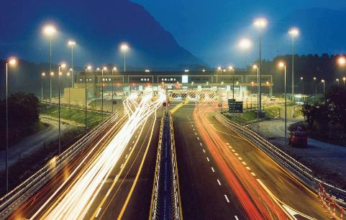
Tecnositaf S.p.A.
Bussoleno, Italy
Goals
    Ensure the highest safety levels through the deployment of a maintenance and infrastructure management system for the A32 Highway and Tunnel
Challenges
    Limit maintenance costs while ensuring maximum safety
Results
    Reduced maintenance and energy consumption of the tunnel lighting and ventilation systems
    Deployment of a fire-fighting system meeting the highest
    safety standards
Industry: Infrastructure
Products: System Platform, Process Historian, InTouch HMI (Standard Edition)
“We invested in the deployment of the most modern safety systems available on the market today, developing solutions enabling us to go far beyond international standards.”
Giuseppe Celia Magno, Sales and Quality Manager
LEARN MORE

Slide 41
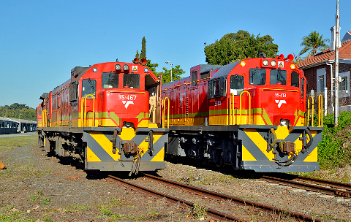
Transnet Saldhana Bay
South Africa
Goals
    A highly scalable system was needed so that Transnet could more
    effectively track material locations and keep pace with the rapid expansion
    of port operations
    Enhance its current routing system so that vital tracking information could be provided to mining companies on demand
Challenges
    Simplifying complex tasks performed by operations personnel was viewed as
    a significant impediment to business expansion
    Integrating the complex conveyor routing network with the port’s material tracking system was considered to be a difficult process
Results
    Wonderware InTouch HMI successfully provided a dynamic, user-friendly routing system that easily integrated with existing platforms
    Transnet was able to eliminate invalid route selections and increase iron ore shipments to 80 million tons annually
    Operations management can check the delivery status of iron ore orders in
    real-time and update mining company status requests
    The system is able to handle potential emergency events
    AVEVA delivered a highly scalable and flexible solution which allows for expansion
Industry: Infrastructure
Products: System Platform, Process Historian, InTouch HMI (Standard Edition)
“The Wonderware-based system is just like using a GPS system. You simply enter the location of the starting point and then the destination, and the application finds the shortest route. It’s so much better than all the buttons we had to push previously in order to search through and find a suitable route for shipping the iron ore.”
Adenaan Jassiem, Control System Engineer
LEARN MORE

Slide 42
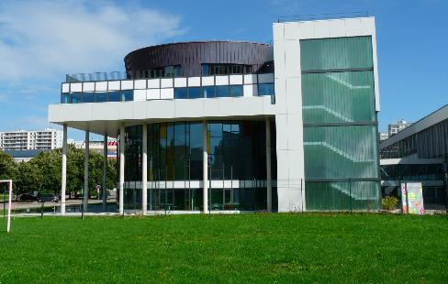
Université de Strasbourg
France
Goals
    Development of a centralized building automation system interacting with heterogeneous equipment
    Easily access equipment’s technical data entered in an asset data management program
    Exchange data with other application software simply
Challenges
    The standards for the supervisory application needed to be defined
    Importing of the System Platform directory structure for the installations and equipment's identified in the asset data management program needs to be executed without any losses.
Results
    Simplified creation of the supervisory system based on the asset data management program
    Better visibility and control of installations based on centralized technical data
    A functional library and standard graphic created for all of the equipment’s being controlled
    Implementation of a technical software platform capable of meeting future needs
Industry: Infrastructure
Products: InTouch HMI (Standard Edition)
“We chose the System Platform to provide a building management system for the equipment in our 140 buildings. “The originality of this application lies in the automatic transfer of the information entered in an asset data management program to the System Platform.”
Damien Bertrand, Manager of the Energy Department
LEARN MORE

Slide 43

The Venetian and Palazzo Resort Hotel & Casino Las Vegas, USA
Goals
    Provide uninterrupted power to the entire resort complex
    Maximize the efficiency of widespread equipment and workforce
    Enable flexibility and adaptability to accommodate rapid growth
Challenges
    Biggest hotel and resort in the world covering 67 acres and 14 million square feet
    66 substations, 62 PLCs and staff are spread out over a large area
    Any disruption of power can result in loss of clientele and revenue
Results
    Power management and redundancy capabilities ensure uninterrupted power 24/7/365
    Real-time monitoring enables proactive trouble shooting and fixes
    Central monitoring of remote substations saves staff time, resulting in bottom line savings
    Reporting and record-keeping capabilities support rapid
    planning for expansion
    Wonderware solution supports green and sustainability Goals
Industry: Infrastructure
Products: Process Historian Clients, InTouch HMI, Process Historian”
“(The Wonderware solution) is a lifesaver. I can’t see not having it.”
Jerry Jaggers, Senior Project Manager
LEARN MORE

Slide 44

Wuxi Transportation Tunnel System
  Wuxi, China
Goals
    Remotely manage the series of tunnels, roads and pedestrian paths
    that connect the city’s residential area, industrial zone and central
    business district
    Ensure the effective management of tunnel conditions and operation equipment including power, lighting, ventilation and drainage as well as emergency response operations
Challenges
    The control center has to rapidly react to emergency events such as accidents, fires and floods in accordance with contingency plans
    Respond to tunnel operations management issues including effective operation of equipment, maintenance of road conditions and management of energy use
Results
    The management team can now efficiently monitor various systems, achieving full deployment of the entire road
    Reduced engineering costs, improved overall operation efficiency and decreased travel time through the central city
    The system now supports more than 10 clients as compared to the previous six clients and achieved a lower headcount
Industry: Infrastructure
Products: System Platform, InTouch HMI (Standard Edition), Process Historian, Process Historian Clients
“The AVEVA solutions use advanced component object-based technology that enable us to reuse templates from previous projects allowing faster implementation of new processes.”
Dr. Wu Zhichun, Mayor of Wuxi
LEARN MORE

Slide 45
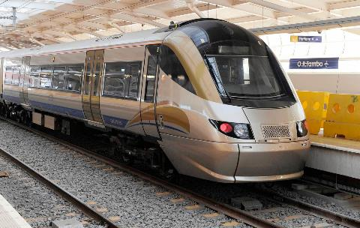
Bombela Concession Company
South Africa
Goals
    To construct a high-speed commuter railway that connected the Johannesburg City center, surrounding suburbs and international airport
    The team needed to implement a safe and efficient tunnel ventilation system to address various emergency provisions, including fire scenarios, pressurization and smoke removal
Challenges
    The project required the development and deployment of applications that could be easily viewed and controlled from a central command center
Results
    The solution helped the operation of a rail line used by 62,000 riders a day, operating on 80 kilometers (km) of railway tracks
    Completed ahead of schedule, enabling Gautrain to be running in time to provide service to more than 300,000 visitors attending the 2010 World Cup
    Integrated the railways 11 sites, while meeting the requirement for 99.7% system availability
    Object-oriented technology enables quick replication and deployment of applications among the various railway sites, reducing engineering cost when new projects are commissioned, or when modifications and upgrades to existing systems are necessary
    Allows for faster operator response times due to new navigation techniques that help them establish alarms and identify faulty equipment more quickly
Industry: Infrastructure
Products: System Platform, InTouch HMI (Standard Edition), Process Historian, Process Historian Clients
“The flexibility of the Wonderware software made it possible to create the extra redundancy and saved a lot of engineering time. It’s truly a pleasure to develop systems with this versatile tool.”
Sheldon Frade, Electrical Engineer, Kentz (Pty) Ltd
LEARN MORE

Slide 46

  UC/DALKIA
  Paris, France
Goals
    Create a solution that will supervise the chilled water production installation used to provide air conditioning for part of the prime Paris-La Défense
    business district
    Providing easy to use block diagrams as the installation welcomes many non technical visitors. This is a showcase for Dalkia, for future national and international customers
    Using open software that is independent of the proprietary standards used by PLC vendors (the installation comprises PLCs from a variety of vendors)
    Efficiently archiving and using all of the process data in a centralized way
Challenges
    Changing supervision software vendors without excessively upsetting operator’s routines and the actual production
    Encouraging operation, especially by implementing a large screen with summary and intuitive graphic presentations for users who are not
    technical experts
Results
    A user-friendly application was created where operators work with
    very easy to use block diagrams that make decision making easier
    A 50-inch screen offers an overall view of the installation with state
    of the art 3D graphics provided by the integrator partner (BASIS) using
    Wonderware tools
    A user-friendly application
    Improved control over operations leading to increased production equipment availability and significant savings in the use of various energies
Industry: Infrastructure
Products: System Platform, InTouch HMI (Standard Edition)
“The HMI solution won us over with its state-of-the-art truly realistic graphics that are more attractive to operators and easier to use too, than the conventional imaging used by the other supervision software that we were offered in response to our request for proposals.”
Rodophe Petit, Head of Operations, SUC
LEARN MORE

Slide 47

Food & Beverage / CPG
47

Slide 48

Amadori Group, GESCO Consorzio Cooperativo Teramo, Italy
Goals
    Optimize temperature management during meat processing steps
    Ensure traceability, with exact temperature data for every step: processing, stocking and preservation
    Deploy a system that improves plant efficiency
Challenges
    Difficulty in software migration from an outdated version to a highly innovative and scalable system
    Create a temperature control system that adjusts according to the external weather conditions
Results
    Solution enabled compliance with government regulations
    Optimized production cycle and energy management
    Automation of the production cycle helped eliminate manual data
    entry errors
    The solution was initially only implemented in limited departments, but has now been deployed in all other process areas
Industry: Food & Beverage / CPG
Products: InTouch HMI (Standard Edition), Process Historian,
Process Historian Clients
“In recent years, Amadori has always been asking for the most innovative solutions, aware that technological innovation allows us to remain competitive on the market. And this Goals has led us to the deployment of Wonderware platforms.”
Carlo Caramanico, Software Support Cid Engineering
LEARN MORE

Slide 49

Amalgamated Beverage Industries
  Pretoria, South Africa
Goals
    To effectively address the annual summer demand for soft drinks, the plant needed to improve the overall production performance and accelerate commissioning of a new packaging line
    The ability to track machine performance, electronic data capture and reporting of measurements were key components to ensuring that the packaging facility operates efficiently
Challenges
    The facility needed to conform to Pack ML standards to ensure efficient operation of facility manufacturing equipment
    The automation system had to work with existing SAP process order applications and daily production reporting Infrastructure
    The company wanted to capture all downtime data using the OMAC model of open control technologies for manufacturing applications
Results
    Once Amalgamated implemented the PackML standards using the OMAC model and Wonderware software, the company was able to accurately achieve real-time downtime reporting
    The company was able to accurately estimate reject counts and crates on the line to implement improvements to the manufacturing line process
Industry: Food & Beverage / CPG
Products: InTouch HMI (Standard Edition), System Platform, Performance,
Process Historian, Process Historian Client
“The accuracy of the downtime reports provided by the Wonderware software solution were so good that even our equipment supplier is using them to troubleshoot its equipment at our plant instead of using manual tracking sheets normally used when servicing the equipment.”
John Coetzee, SAB Business Systems Manager, Manufacturing
LEARN MORE

Slide 50

Auto-bake
  Sydney, Australia
Goals
    Provide a baking system that blend traditional practices with
    modern technology to provide baked goods that look, feel
    and taste “homemade”
Challenges
    Create a fast yet secure production system
    Design a vertical oven with a reduced footprint with increased production flexibility
Results
    Increased plant uptime through improved diagnostics and troubleshooting functionality
    Reductions in the number of personnel required to operate the
    baking line
    Data logging of process values and a historical audit trail of alarms
    and events
    Decreased overall testing and commissioning times
    Global language support, in which a single
Industry: Food & Beverage / CPG
Products: InTouch HMI, Industrial Computers
“The quality of our end-products has improved because we can now spend more time on quality assurance and less time replicating the same data on multiple computers.”
Paul Brennan, Senior Electrical Engineer
LEARN MORE

Slide 51
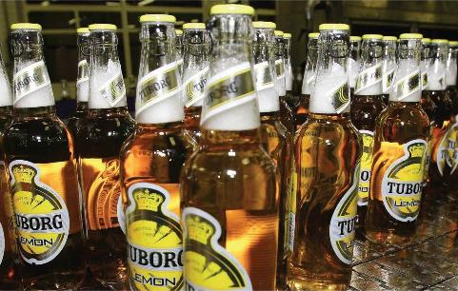
Baltika Breweries
  St. Petersburg, Russia
Goals
    The brewery required a modular automation software solution that would
    enable operations management to scale the system to meet future
    production requirements
    Reduce costs through improved equipment performance, lowered material losses, reduced production costs and better supply chain processes from distributor warehouses
Challenges
    Ensure that a new automation software solution could effectively integrate with existing hardware and software
    With increasing global competition, reducing the facility’s production cost was a top priority for any new software implementation
Results
    The reduction of 8 percent in energy usage during the manufacturing process has enabled Baltika to lower its overall operating costs
    A 5 percent reduction in steam consumption during the beer manufacturing process has been achieved
    The cost of packaging materials has been lowered by 1.8 percent
    Baltika can now accurately determine production losses per batch and has achieved a reduction of 0.56 percent in extract loss
Industry: Food & Beverage / CPG
Products: InTouch HMI (Standard Edition), Performance ,Process Historian Client, System Platform
“The comprehensive AVEVA MES solution has provided a significant increase in the accuracy of our process control system enabling our operators to monitor the manufacturing lines in real time and more quickly react to anomalies that might occur.”
Yuriy Chentyrev, Director of Operations
LEARN MORE

Slide 52

Beam Global Spirits and Wine
  Clermont, Kentucky
Goals
    Stay true to the original 200-year-old bourbon recipe
Challenges
    Improve spirits and wine plant technology while maintaining the
    quality of a product that has a 200-year-old tradition
    Clear upgrade path of automation system to allow improvements as
    technology evolves
Results
    Increased efficiency in operations and engineering due to
    Wonderware software’s ease of use
    Consistent product quality due to automation
    Full plant integration involving manufacturing
    and Infrastructure management
Industry: Food & Beverage / CPG
Products: System Platform, InTouch HMI (Standard Edition), Process Historian, Process Historian Clients”
“With regards to metrics, what we’re seeing is consistency in throughput. We are able to tell when problematic areas arise and by having it automated, we are able to take preventive action in order to maintain consistent operation.”
Harry Crigler, Distillery Operations Manager
LEARN MORE

Slide 53

Coca Cola Swaziland Conco Ltd
  Swaziland
Goals
    Reduce energy consumption by 20% and increase visibility into the production processes
Challenges
    The old model was to take a holistic view of energy cost rather
    than usage
    The energy users were not empowered enough to take control
    of situations in the plant
Results
    The improved visibility into energy usage and cost per plant and subsection and the implementation of smarter energy usage/cost control protocols resulted in a reduction in energy consumption.
    Gaining the ability to control high energy operations to take place during low-cost periods and having the staff be immediately aware of their immediate impact on energy cost resulted in a tighter grip on corporate departmental budgets and targets
Industry: Food & Beverage / CPG
Products: System Platform, InTouch HMI (Standard Edition), Process Historian, Process Historian Client
“...after the Swaziland Electricity Company validated the results and achieved a discrepancy of less than 1%, the business completely bought into the system.”
Paul Kotze, Senior Software Engineer, Systems Anywhere Coastal
LEARN MORE

Slide 54
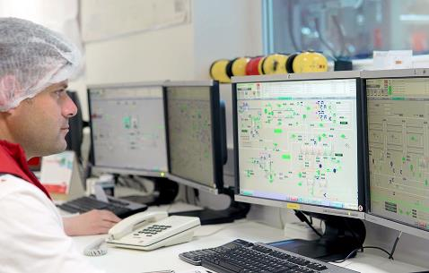
Eker Dairy
Turkey
Goals
    To transition to a fully automated production facility
    To achieve the highest level of product tracking and traceability
    To enable the engineering team to create powerful templates that provided the flexibility required by the Eker production process
Challenges
    Operators were manually processing analog data which took time away from overall production
    Tracking and tracing of quality issues were inconsistent and subject to errors due to manual inputting of data
Results
    Eker has increased its production capacity to more than 600 tons of product per day and continues to grow
    Product quality and production traceability has increased significantly
    The Eker production team has applied the concept of Industry 4.0 enabling operations, team members and devices to communicate and operate seamlessly via IoT
Industry: Food & Beverage / CPG
Products: InTouch HMI (Standard Edition)
“Eker needed a software platform that would enables us to create powerful templates that are flexible at the same time. Wonderware software provided this and more.”
Yavuz Selim Aydin, Project and Engineering Manager
LEARN MORE

Slide 55

F&N Dairies
Thailand
Goals
    To enable the dairy to achieve quality track and traceability
    To facilitate connectivity of plant operations with the plant’s industrial automation devices, computers and laboratory measuring instruments
    To reduce the total cost of ownership of the overall solution by enabling easy upgrades of systems across the enterprise
Challenges
    When quality parameter deviations were detected, the operators had to manually trace the information in the archived, paper-based operations sheets to determine the root cause, which took a tremendous about of time
Results
    The plant achieved production Goals of 2,500 cans a minute, equaling 3 million cans a day, which equals 24 million cases a year
    It reduced quality traceability time from 4 hours to 1 minute
    The manufacturing facility achieved its return on investment within one year
    The plant achieved "100 Percent First-Time Quality," a lean metric that indicates what parts are manufactured correctly the first time without need for inspection, rework or replacement
Industry: Food & Beverage / CPG
Products: System Platform, InTouch HMI (Standard Edition), Process Historian, Process Historian Client, Performance”
“At our Rojana factory, F&N Dairies produces 3 million cans a day of sterilized milk, or 2,500 cans per minute. With the integration of Wonderware software solutions to provide vital data on production processes as well as track and trace, we are able to have comprehensive control of our manufacturing operations to ensure product quality and control.”
Somchai Khwahan, Production Manager, F&N Dairies Thailand
LEARN MORE

Slide 56
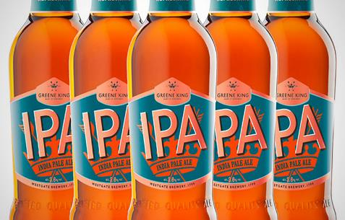
Greene King
United Kingdom
Goals
    To make sure that within the Brewery, everything is consistent, stays under control and everything is executed at the right time
Challenges
    To be able to extend a standard SCADA solution to all parts of
    the brewery
    To enable automatic data gathering and improve plant production
Results
    Single plant wide standard - all displays are now recognisably similar across the current systems, this allows operational staff to be deployed more flexibly across the business as they quickly feel familiar with the process interface Historian is proving to provide reliable information in high fidelity, missing nothing that needs to be seen and working continuously as the plant runs, week in and week out
Industry: Food & Beverage / CPG
Products: Process Historian, InTouch HMI (Standard Edition)
“Wonderware delivers consistency, product uniformity and repeatability, assisting us in getting it right the first time.”
Roy Matchwick, Greene King Automation Engineering, GreManagerene King PLC
LEARN MORE

Slide 57

Hawaiian Commercial & Sugar Company
  Puunene, Hawaii
Goals
    Continue to sell sugar products while increasing the efficiency of the manufacturing system
Challenges
    Find a way to further optimize the plant operations
Results
    Increased efficiency and production because all areas in the plant can now view each other’s operating data
    Employees can access data from throughout the production process from any workstation in the plant or any remote workstation
    around the world
Industry: Food & Beverage / CPG
Products: InTouch HMI (Standard Edition), Process Historian,
Process Historian Clients
“The system has changed our way of thinking and the way we operate. It has opened up more interdepartmental communication.”
John Rivera, Power Management Analyst
LEARN MORE

Slide 58
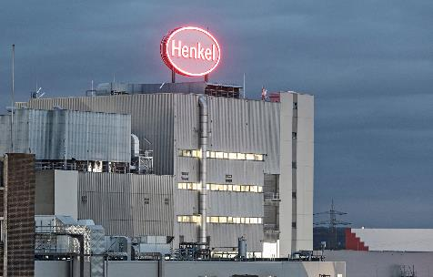
Henkel
Germany
Goals
    To reduce specific energy consumption and support ISO 50001 certification for all production sites.
    To improve supply-chain resource efficiency on the production side by 5 to 6 percent annually, 75% increase of overall efficiency by 2020, and finally,
    to be three times more efficient by 2030.
    Challenges
    Improvements were needed in the collection, use and communication of consumption and emissions data across the length of its global supply chain.
    Results
    Solution support for growth and sustainability strategies has resulted
    in 9% reduction in energy consumption, this translates to €15 million
    in energy costs saved.
    Reduction in filling line waste and elimination of all incorrect labeling
    resulted in 100% label quality.
    Performance installation has demonstrated measurable improvements
    of 4.5% in OEE after just one year.
Industry: CPG
Products: System Platform, Process Historian, Performance, Intelligence
“We succeeded in making global energy consumption data available to our supply chain managers in real time.”
Dr. Dirk Holbach, Corporate Senior Vice President
Global Supply Chain Laundry & Home Care Sector
LEARN MORE

Slide 59
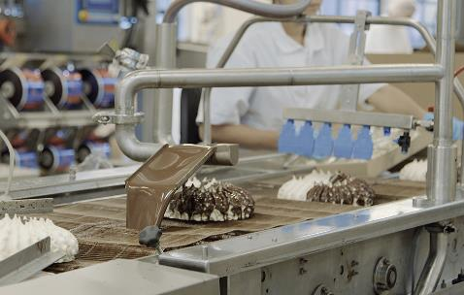
Hennig-Olsen
Kristiansand, Norway
Goals
    To establish a standardized software system with in-house control
    to accurately track production processes
    To effectively manage quality operations ensuring product safety
    and compliance
    To strengthen inventory control, traceability of material usage
Challenges
    The previous system did not allow for immediate access to reporting
    and plant data metrics
    Quality measurement data such as product temperature and maturity
    tracking was unreliable
    Management was unable to effectively manage the production of its various food products throughout its manufacturing Infrastructure
Results
    The company can successfully track processes from warehouse, to the production lines enabling it to maintain is 48% market share
    Operations are simplified and the company is able to measure materials in
    real time anywhere, as well as know the specific batch, date and amount of ingredients used
Industry: Food & Beverage / CPG
Products: Manufacturing Execution System
“The most important improvement is that we now have one single system for our entire operation that allows us to be more flexible when it comes to personnel and suppliers, by providing a standardized system and a higher level of automation.”
Marianne Stordal, Director of Production
LEARN MORE

Slide 60

Hudson & Knight
South Africa
Goals
    Improve insight into complex processes
    Lower the total cost of ownership of the supervisory system
    Cope with changing product and market demands
    Improve and maintain product quality
Challenges
    Cope with frequent changes in technical staff
    Stop the erosion of skills
Results
    Enforced standardization
    Decreased downtime and callouts
    Increased information to operators as well as to process and engineering personnel
    Lower cost of ownership
    Uses up-to-date technology
    Off-the-shelf implementation
    Ease of integration with third-party applications
Industry: Food & Beverage / CPG
Products: System Platform, InTouch HMI (Standard Edition)
“The installation of the Wonderware System Platform has meant that we can aim higher. While it can now help us optimize production, it’s also laid the foundation for much more.”
Noël Alleaume, Factory Manager, Hudson and Knight
LEARN MORE

Slide 61

Imana Food Ltd
South Africa
Goals
    Full traceability of all materials entering and leaving the Savoury Powders
    blending process
    Visibility into the blending process Production data to be linked in to the company’s ERP system
    Gain HACCP certification
    Improve the quality of finished goods
    Reduce inventory discrepancies
Challenges
    Tracking of all incoming raw materials used in more than 150 recipes
Results
    HACCP certification achieved within three months of going live
    Better insight into the blending operation in the factory
    Improved raw material stock control
    Real-time blend closure in the ERP system
    Factory procedural deviations are highlighted
    More consistent product quality from following recipes exactly
    Improved management of the physical blending process
    Proper temperature control of sensitive blends
Industry: Food & Beverage / CPG
Products: System Platform, Process Historian, Manufacturing Execution System, InTouch HMI (Standard Edition)
“Imana Foods would not have acheived HACCP accreditation without this solution in place."
Paul Alcock, MD, Imana Foods’
LEARN MORE

Slide 62

JSC Bashkir Soda
Russia
Goals
    Automatic data collection, real time processing and display of information from the metering points in graphical and tabular form
    Control over reliability of the information coming from the sensors and systems with manual entry of values from points at non-automated sites
    Registration and storage of information on controlled parameters
    Audible and visual alarm for process and system violations
    Automatic calculation and representation of commodity balances (including snapshots) for each redistribution
Challenges
    The necessity for the development and introduction of a new system in which measuring accuracy should satisfy all modern commercial requirements, with full automation of accounting and balance functions
Results
    A single interface for all production stages with a concise, comprehensive model detailing the entire production process
    Easy integration of pre-existing automated production Systems
    Single multi-user object-oriented development environment, system deployment and maintenance
    Client-server architecture for the creation of dispatch interfaces.
    Reduced loss of raw materials
    Qualitative distribution of finished products by grade type
    Reduction in the number of emergency stops through MRO equipment forecasting
Industry: Food & Beverage / CPG
Products: Device Integration Server, Application Server, Process Historian,
InTouch HMI (Standard Edition), Information Server
“In order to assess the ease of integration of third-party data into the system within a relatively short period of time, company specialists established a link between all existing operating systems and enterprise dispatch systems. A full consolidation of the data allowed for the possibility of a full data set to be analyzed and the use of different valuation techniques to obtain additional data.”
Oleg Petrov, Head Office of Automation, JSC Bashkir Soda Co.
LEARN MORE

Slide 63
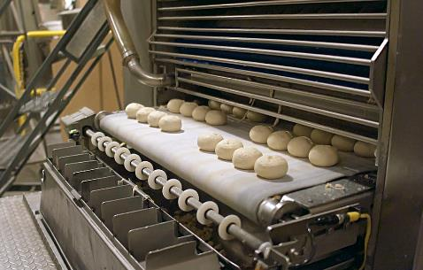
La Tortilla Factory
Santa Rosa, California
Goals
    Reduce product waste with more precise water usage
    Improve line performance by empowering operators with raw materials visibility and actionable system data while reducing unplanned downtime
    Move from a paper based system to electronic data collection
    processing and analysis
Challenges
    Previous system was ill-equipped for scalability and process improvements
    Low visibility from plant floor machine data would lead to excess product
    “give away” and waste
    Extensive paperwork and paper reporting was slowing the ability to gather operational data or implement meaningful changes
    Multiple equipment manufacturers were supplying fragmented operational data
Results
    Wonderware System Platform was implemented in 4.5 months
    La Tortilla Factory was able to improve line efficiency within 6 months
    Less than 1 year after system rollout, La Tortilla Factory is seeing ROI
    La Tortilla Factory sees a 5% increase in product yield and 2% decrease in
    product waste
Industry: Food & Beverage / CPG
Products: System Platform, InTouch HMI (Standard Edition)
“We’re constantly trying to come up with ways to drive costs out of the business. We wanted to implement a shop floor system that allowed us to have real time data at our fingertips in order to improve and drive costs out of the business.”
Katie Evans, VP of Operations
LEARN MORE

Slide 64

MARS Deutschland GmbH
Germany
Goals
    Compliance with legal regulations within a strictly regulated
    production environment
    Continuous production control and complete product tracing
    Connection to different production and automation systems
Challenges
    Regulated production environment
    Multiple production and automation systems to integrate
Results
    Open and flexible system integration
    Scalability of the applications
    Consistent process protocols
    Guarantee of product quality even exceeding legal requirements
Industry: Food & Beverage / CPG
Products: Operations, InTouch HMI (Standard Edition), System Platform
“Thanks to the open system connectivity Mars benefits not only from an integrated system solution but also from the flexibility to continuously scale and adapt the system applications”
Günter Osswald, Managing Director, G&O Automatisierungsgesellschaft
mbH & Co. KG
LEARN MORE

Slide 65

Namibia Breweries
South Africa
Goals
    To accurately record critical production information from the solar, NH3 cooling, boilers, and CO2 plants, as well as from the water and power meters
    To transfer production information to the existing DCS
    To develop a dashboard system for management to view consumption-related information linked to production volumes and KPIs
Challenges
    The plant operations team faced reservations from the department management groups that these goals could be achieved, therefore, they needed a convincing argument of the benefits to acquire “buy in” from all stakeholders for implementation of the system
    With massive amounts of plant data required to be processed, NBL faced the issue of time synchronization between Wonderware Historian and its current OPC server
Results
    NBL successfully achieved compliance with municipal regulations
    The renewable energy system supported with Wonderware Historian provides for 8% of NBL’s electricity demand as well as approximately 4.23 million kWh of green energy
    NBL has achieved a savings of 4,230 tons of carbon dioxide (CO2)
    Precise verification of KPIs can now be obtained to evaluate plant processes and related equipment operations
Industry: Food & Beverage / CPG
Products: Process Historian, Process Historian Clients
“It is an amazing feeling to see the end result and the satisfaction on the faces of the end user. It’s even more gratifying to see the value the business has derived from this Wonderware-based software solution.”
Andre Engelbrecht, Manager of Industrial Control Systems
LEARN MORE

Slide 66
New Belgium Brewing Company
  Fort Collins, Colorado
Goals
    New Belgium Brewing has set an ambitious objective to reduce its wastewater impact by increasing its waste diversion rate (sans spent
    grain and sludge) from 73% in 2007 to 95% by 2015
    By 2015, the company plans to decrease the water use per barrel
    of beer produced by 10% and curtail greenhouse gas emissions by 25%
Challenges
    With the reduction in energy usage and materials consumption,
    New Belgium Brewing was concerned about maintaining
    high manufacturing standards
Results
    The AVEVA solution helped in the efficient and sustainable production of more than 600,000 barrels (18 million gallons)
    of beer annually
    The methane rich biogas byproduct from the wastewater plant is now captured and converted into electricity, producing 15% of New Belgium’s operating power requirements
    The solar photovoltaic panels installed on the roof of the bottling plant are able to produce up to 200 KW
Industry: Food & Beverage / CPG
Products: InTouch HMI, Performance
“One of New Belgium Brewing’s core values is to honor nature at every turn. The health of our community and of our business depends upon the health of the natural environment.”
Jennifer V. Orgolini, Director of Sustainability and Strategic Development
LEARN MORE

Slide 67

New Belgium Brewing Company
  Fort Collins, Colorado
Goals
    Install an Enterprise Manufacturing Intelligence and Manufacturing Execution System that will improve inventory management, increase production accuracy and improve quality control
Challenges
    Reduce time spent entering data and manually checking the movement
    of materials
    The PLC-based batching system was not operating at its full potential
    The clean-in-place (CIP) information was not readily accessible
    Quality control procedures were performed by hand
Results
    “Track and trace” capability enables tracking of any product
    within 30 minutes
    Key Performance Indicator (KPI) scorecards provide immediate information about performance
    Historical analysis enables optimization of energy use
    Faster trouble shooting; improved response times for corrections
    Early detection of product deviations
    Projected ROI for integration costs will be realized within two years
Industry: Food & Beverage / CPG
Products: InTouch HMI (Standard Edition)
“From an administrative perspective, we save a lot of time. From a user’s perspective, we minimize frustration. That’s the number one benefit.”
Igor Valuyev, Chief Electrical and Automation Engineer
LEARN MORE

Slide 68
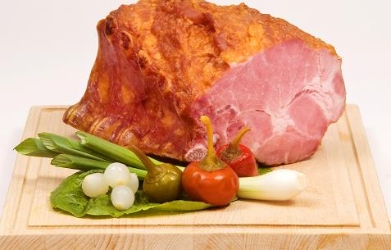
Nomanet SP. Z.0.0.
Poland
Goals
    Increase production effectiveness
    Coordination between Business and production Goals
Challenges
    Improve operational excellence
    Integration with production machines
    ERP and MES integration
Results
    Improved information flow
    Improved equipment effectiveness
    Less paper work and manual data entry
Industry: Food & Beverage / CPG
Products: InTouch HMI, Performance
“Correlation between business and production Information allows business managers to effectively make decisions critical for the company. MES system uncovers certain relationships which results in cost cutting opportunities and production effectiveness increase.”
Pawel Drobny, IT Department Vice Manager, Queris Sp. z o.o.
LEARN MORE

Slide 69

Orley Foods
  Cape Town, South Africa
Goals
    Full product traceability
    Seamless and transparent integration of manufacturing and business systems throughout the company
    Trend and trace process issues in order to speed up trouble shooting while conforming to regulatory requirements
Challenges
    Re-engineering of Orley Foods’ process control and information
    delivery infrastructure
    The plant model would have to be designed to handle the entire plant
    and not just certain aspects of the chocolate production facility
Results
    Consistent batch sizes
    Raw material allocations tracked
    Better process control tracking
    Significant savings in fat usage
    Standardization of batch processing times
    Minimized batch/formulation corrections
Industry: Food & Beverage / CPG
Products: InTouch HMI, System Platform
“We found that the Wonderware solution was best suited, as it had a proven track record in the Food & Beverage / CPG industry and was used in many local and international plants involved with food production.”
Henk de Villiers, Operations Manager
LEARN MORE

Slide 70
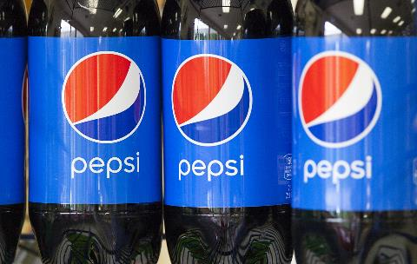
Pepsi Bottling Ventures
  Garner, North Carolina
Goals
    Develop a Performance and Downtime tracking system
    Eliminate guesswork and assumptions through collection of consistent
    and reliable data
    Justify Return On Investment for future capital plant projects
    Develop an enterprise level platform for future expansion
Challenges
    Implement the new system across 1 new line and 4 legacy lines in the plant
    Downtime data was recorded manually and information gathering was subjective and inconsistent
    Manually recorded data created more questions than answers
Results
    Produce over 30 million cases of Pepsi products a year
    PBV Garner has grown from producing & distributing 189 different
    products to over 500
    Total payback for investment estimated at 2.8 years
    Ability to discover, validate and quantify opportunities for future
    capital investment
    Average Filler Runtime data facilitated increased production numbers
Industry: Food & Beverage / CPG
Products: InTouch HMI (Standard Edition)
“We have to make the right decisions everyday because it is a huge impact on our bottom line. Wonderware helps us make those decisions.”
Scott Jamison, Vice President of Engineering
LEARN MORE

Slide 71
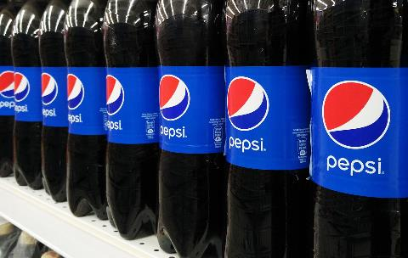
Pepsi Bottling Ventures
  Nampa, Idaho
Goals
    Improve changeover performance by accurately identifying constraints
    and bottlenecks
    Facilitate better decision making for cross functional teams through consistent and reliable data which would eliminate guesswork
    and assumptions
    Understand payback metrics and use this data to justify future projects requiring capital investment
Challenges
    The new plant required the integration of new and legacy equipment
    Downtime data was recorded manually, and this tracking system did not include recently installed equipment
    A lean headcount meant that engineers’ time was at a premium
Results
    Cause of downtime in changeover process identified, leading to 50% reduction in changeover time and additional savings in raw materials
    and packaging
    Plant has achieved an overall 10% increase in line efficiency
    Total payback for investment took less than one year; annualized savings calculated at over $78,500
Industry: Food & Beverage / CPG
Products: InTouch HMI (Standard Edition)
“With more detailed data available from the PLCs in real-time, we are able to cost justify upgrade projects specifically for certain machine centers. We’re able to prove the need for more capital investment.”
Chris Bacon, Project Manager
LEARN MORE

Slide 72

The South African Breweries Limited
  Caledon, South Africa
Goals
    Track products through the production process in order to get a complete view with respect to production variables applicable
    to each batch
    Generate reports detailing product transfer times and vessel
    occupancy times
Challenges
    Merging of production and process timelines into a single source of information, with all the data in context, for meaningful numerical and graphical reports regarding production KPIs
    Safeguarding existing system investments
Results
    The new system has highlighted operational and plant issues, which had previously been “hidden” from view
    True vessel occupancies and transfer times can be determined
    Real-time data provided in the correct format has now made users more aware of true production realities
    Meaningful information is helping SAB Maltings achieve its overall objective of continuous process improvement
Industry: Food & Beverage / CPG
Products: InTouch HMI, Operations, System Platform
“All in all, for the first time, we now have an automated system giving us the information to achieve what everybody is striving for – continuous improvement.”
Eddie Jordaan , IS Manager
LEARN MORE

Slide 73
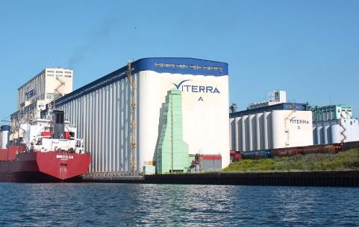
Viterra
Canada
Goals
    Operate at rated capacity across multiple geographically
    dispersed Infrastructure
    Expedite shipping efforts by adopting leaner, more efficient load-in practices
    Establish scalable operational practices to meet increased demand for grain across global distribution channels
Challenges
    Lack of process standardization across multiple Infrastructure limited production visibility and quality assurance
    As systems became dated, production requirements were outgrowing
    system capacity
    Varying expertise required by operators increased the training time and learning curve for new workforce, and threatened consistent production
    quality across sites
Results
    10% increase in shipping efficiency, shaving 45-60 seconds off load-in
    for each car
    40% decrease in rail receiving time by implementing standardized instrumentation and operator controls
    System development cycle has been shortened from 4 months to 4 weeks
Industry: Food & Beverage / CPG
Products: System Platform, Intouch, Process Historian
“We’re very proud of what we’ve done—where we’ve been.
We started from a small business over 100 years ago and
we’re a global company today.”
Paul Bourlon, Manager Automation Services
LEARN MORE

Slide 74

Winkler und Dünnebier Süßwarenmaschinen GmbH Germany
Goals
    Effective production visualization
    Design of complex visualization and data systems
    Use of standard templates
Challenges
    Interfaces to a wide range of systems
    Open to suppliers of different systems
Results
    50% reduction of development time
    Substantial simplification of plant management
    Easy replacement of clients in case of failure
Industry: Food & Beverage / CPG
Products: System Platform, Process Historian, Industrial Computers,
InTouch HMI (Standard Edition)
By using System Platform, we could cut development cycle time for large visualization and data systems into half, while substantially improving standardization”.
Bernd Plies, Electric and Automation Technolo
LEARN MORE

Slide 75
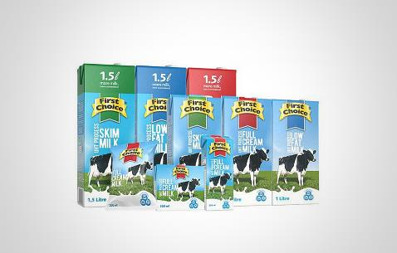
Woodlands Dairy (Pty) Ltd
South Africa
Goals
    To create a redundant, reliable and flexible system using a single platform that will integrate all the disparate plants on site
Challenges
    The system has to comply with ISO 22000 standards
    The project must be completed without any interruptions to production
Results
    Achieved compliance with ISO22000
    Reduced engineering cost while improving quality control
    Improved troubleshooting capabilities
    Accurate reporting and standards in place for future use
Industry: Food & Beverage / CPG
Products: System Platform, InTouch HMI (Standard Edition) Process Historian, Process Historian Clients
“The Wonderware technology and products have helped increase our level of knowledge and control to the degree that we can now think about improving our processes rather than just keeping up with them.”
Jan Barnard, Process Engineer, Woodlands Dairy
LEARN MORE

Slide 76

Life Sciences
76

Slide 77

Baxter S.A.
  Lessines, Belgium
Goals
    Increasing production capacity while significantly reducing manufacturing throughput time was a top priority for Baxter
    The new automation system needed to assist Baxter in achieving
    U.S. Food and Drug Administration (FDA) 21 CFR Part 11
    compliance regulations
Challenges
    Production management had to be centralized and include reporting, analysis, traceability and performance monitoring to adhere to FDA 21 CFR Part 11 regulations as well as European compliance standards
Results
    The implementation of the new software system doubled the manufacturing facility’s productivity
    Baxter’s manufacturing processes are now fully traceable and meet all FDA and European regulations
    Software system enabled the BiiON engineers to create roughly 35 reusable generic objects, which are stored in a central library
Industry: Life Sciences
Products: InTouch, System Platform, Batch Management, Process Historian
“To be successful, strategic projects require excellent collaboration between the customer, the software vendor and integrator. By establishing the automation framework, the software solutions enabled our project teams to focus on productivity targets.”
Serge Bassem, CEO, BiiON (Baxter System Integrator)
LEARN MORE

Slide 78
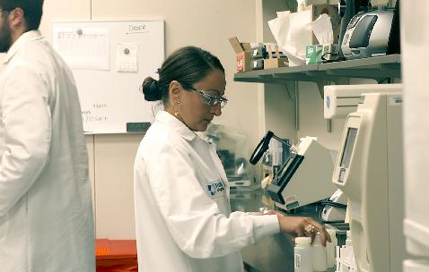
Fujirebio Diagnostics, Inc.
  Malvern, Pennsylvania
Goals
    To replace an existing paper-based GMP record system and manual process with an electronic monitoring system
Challenges
    A significant amount of time is spent each day manually reviewing reports
    The existing paper-based system was time consuming and vulnerable
    to reporting errors
    A new system must enable the company to remain in compliance
    with federal regulation
Results
    The company’s Electronic Initiative helps produce 75 million tests that are distributed throughout the world
    The solution is completely paperless and provides electronic record collection
    with electronic signatures while maintaining 21 CFR compliance and
    ISO 9001 and 13485 certification
    The equipment monitoring system saves about 1,100 man hours per year
    The tasks related to manually logging equipment parameters and reviewing paper logs and charts is eliminated and has reduced data reviewing time from
    15+ hours to just minutes
    Electronic monitoring saves 2/3 of time, or about 10 hours per month
    in quality assurance
Industry: Life Sciences
Products: System Platform, Workflow Management, Process Historian®,
InTouch HMI (Standard Edition)
“The largest benefit of the equipment monitoring system is that we are logging automatically now rather than manually, so it’s saving us about 1,100 man hours per year.”
Josh Zimmer, Quality Engineer, Fujirebio Diagnostics, Inc
LEARN MORE

Slide 79
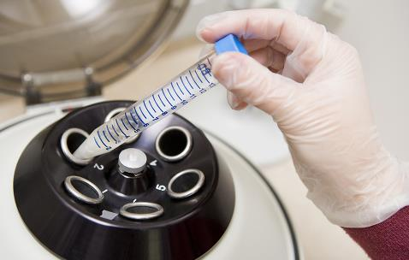
Rottendorf Pharma GmbH
Germany
Goals
    Monitoring of production, laboratory and storage conditions throughout
    the enterprise
    Proper collection and long-term preservation of monitoring and process data
    Visualization and distribution of alarms and notifications
    Flexible data analysis and standard reporting
    FDA-compliant storage of GMP-relevant parameters
Challenges
    Monitor environmental conditions through a multi-stage alarm system
    Compliance with legal requirements and regulations
    Qualified system environment/application
    GMP-compliant user administration
    High product safety combined with maximum production flexibility
Results
    Collection, analysis and storage of GMP- critical parameters – including
    differential pressure, temperature e relative humidity - in production,
    laboratory and storage areas.
    System-generated users alarms in case of specification violation, including escalation mechanisms
Industry: Life Sciences
Products: System Platform, Process Historian,
InTouch HMI (Standard Edition)
“Individual GMP-compliant automated systems bring benefits especially in situations where consistently high quality and flawless monitoring of manufacturing conditions are required.”
Hironobu Hirakawa, Development Manager
LEARN MORE

Slide 80
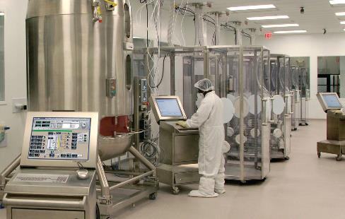
Xcellerex
  Marlborough, Massachusetts
Goals
    Address the growing demands in the biomedical market space for more effective biopharmaceutical manufacturing processes
    Develop a solution that would define a model for improving how biopharmaceuticals, vaccines and other therapeutics are developed, manufactured and commercialized
Challenges
    Integrating complex technology with ultra-high levels of functionality was considered the greatest challenge in creating a biomanufacturing platform that employs a single-use technology, controlled environment modules, process automation and electronic batch records
Results
    Xcellerex’s FlexFactory achieves significant cost savings, including a capital investment reduction that can exceed 60 percent
    Reduces deployment time from three to five years to 12 to 18 months
    The solution achieves an overall reduction in development time of nearly 60 percent, with an estimated 80 percent saving in rework time
Industry: Life Sciences
Products: System Platform, InTouch HMI (Standard Edition), Batch Management, Process Historian
“We’ve been able to reduce deployment time from 3-5 years to an amazing 12-18 months. This results in huge implementation savings and the ability to begin producing high value product 2 to 4 years sooner than traditional technology.”
John A. Chickosky, Chief Commercial Officer and President, Biosystems
LEARN MORE

Slide 81

Metals, Minerals
and Mining
81

Slide 82
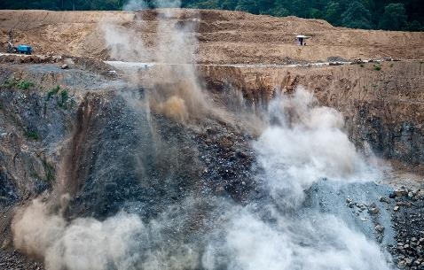
African Explosives Limited
  Johannesburg, South Africa
Goals
    The company needed to accurately track raw materials and finished products through an automated batch tracking system
    With a system featuring the collection of track and trace data,
    African Explosives Limited wanted to ensure product quality
    and eliminate product defects
Challenges
    The company needed to avoid major production disruptions by ensuring a rapid implementation of the new system
    Maintaining the company’s high safety standards and product consistency were the top priorities for any technology changeover
Results
    African Explosives Limited now has an accurate and reliable
    tracking system
    The AVEVA technology solution has improved the company’s competitive positioning by enabling it to deliver high-quality explosives to the mining and construction industries
    Elimination of paperwork has resulted in a significant reduction in errors associated with the prior manual reporting system
Industry: Metals, Minerals and Mining
Products: InTouch HMI (Standard Edition)
“With Wonderware Equipment Operations Module, improved raw material and product tracking gives African Explosives Limited a far greater degree of quality control, enabling the company to maintain product consistency and process improvements.”
Ronald Huggins, Control Systems Engineer
LEARN MORE

Slide 83
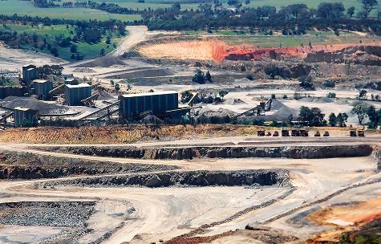
AngloGold Ashanti, Ltd.
Johannesburg, South Africa
Goals
    The company needed to accurately track raw materials and finished products through an automated batch tracking system
    With a system featuring the collection of track and trace data, African Explosives Limited wanted to ensure product quality and eliminate product defects
Challenges
    The company needed to avoid major production disruptions by ensuring a rapid implementation of the new system
    Maintaining the company’s high safety standards and product consistency were the top priorities for any technology changeover
Results
    African Explosives Limited now has an accurate and reliable
    tracking system
    The AVEVA technology solution has improved the company’s competitive positioning by enabling it to deliver high-quality explosives to the mining and construction industries
    Elimination of paperwork has resulted in a significant reduction in errors associated with the prior manual reporting system
Industry: Metals, Minerals and Mining
Products: Process Historian Clients, InTouch HMI, System Platform
“With Wonderware Equipment Operations Module, improved raw material and product tracking gives African Explosives Limited a far greater degree of quality control, enabling the company to maintain product consistency and process improvements.”
Ronald Huggins, Control Systems Engineer
LEARN MORE

Slide 84
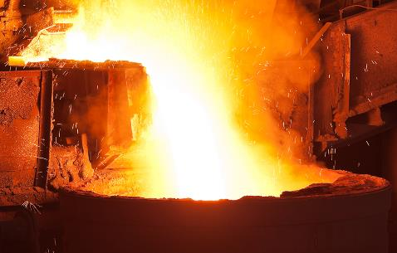
ArcelorMittal
South Africa
Goals
    Shorten project delivery
    Definition of object and graphical standards
    Definition of a standard PLC tag naming convention
    Provision of reliable data tracking
    Include operator accountability
Challenges
    12-week implementation schedule
    Enforcing the application of best practices
Results
    Far greater turnover than would have previously been possible;
    Full product traceability
    Reduced engineering costs on system expansion or duplication
    through standards
    technology can be a vertical as well as a horizontal tool for integration
    Standardized environment is a great steppingstone for
    future automation
Industry: Metals, Minerals and Mining
Products: Process Historian Clients, InTouch HMI, System Platform
“...technology supports our strategic intent and that’s why we love it.”
Joao Bordalo, Senior Architect, MES Demand, ArcelorMittal South Africa
LEARN MORE

Slide 85
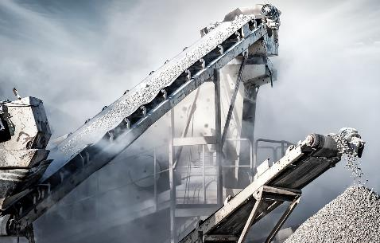
Ash Grove Cement
Overland Park, Kansas
Goals
    Automate maintenance data collection at each facility for a well-defined enterprise asset management process to support equipment performance reliability
Challenges
    Improve the availability and utilization balance of production assets and develop a standardized solution for each of its nine separate production Infrastructure, while maintaining production
Results
    A $2 million first year inventory reduction
    Improved ability to manage inventory, as many as 8,000 items at each plant, maintaining between $2 million to $12 million in inventory
    Compliance with the Federal Environmental Protection Agency (EPA) regulation called the Portland Cement Maximum Achievable Control Technology (PC MACT)
    Minimizes the potential loss of $3,000 per hour for every hour the
    kiln is offline
Industry: Metals, Minerals and Mining
Products: Enterprise Asset Management
“By closely monitoring and managing what we use, reorder activities, and parts and materials pricing, we have reduced inventory by at least $2 million in the last few years. This is a significant contribution to keeping our prices competitive in the marketplace.”
Mike Ralls, Plant Systems Administrator
LEARN MORE

Slide 86
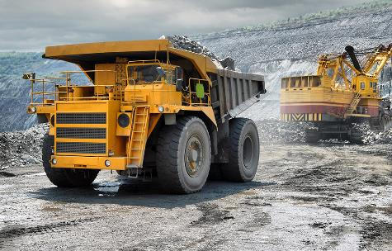
Assmang Limited
Johannesburg, South Africa
Goals
    Transition fuel system from oil/gas to coal
    Comply with EPA regulations and reporting guidelines
    Improve product quality and consistency
    Expand plant and ensure future scalability
Challenges
    Facility built in the 1800s, operating with outdated electrical systems
    and equipment
    Plant is spread out over 65 acres
    Huge power requirements to operate kiln
    End-product uniformity dependent on consistent kiln temperature
Results
    Ability to plan and schedule maintenance brings cost savings of $5,000
    each time a pre-heat/re-heat of the kiln is avoided, resulting in total savings
    of over $100,000
    Remote monitoring added for improved visibility and management of
    overall operation
    Operators more efficient due to at-a-glance ability to assess plant conditions
    Scalability and standardization ensure quick and easy equipment
    additions and expansion
Industry: Metals, Minerals and Mining
Products: Process Historian Clients, InTouch HMI, System Platform
“Allowing local control of equipment using the tablet computers and wireless network has easily paid for itself in savings compared to the cost of running conduit and wire for local control.”
Andy Holtom, Manager of Electrical, Engineering Services
LEARN MORE

Slide 87
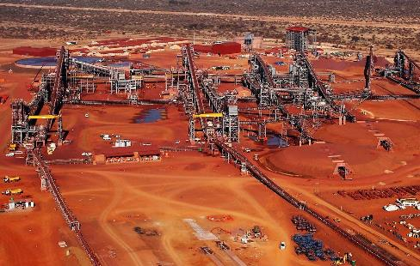
Assmang Limited
Johannesburg, South Africa
Goals
    Monitoring of the new mine’s processes and production infrastructure
Challenges
    Fast track implementation in a massive Greenfield project that
    included nothing less than the creation of a mega iron ore mine
    from the ground up
Results
    The definition and enforcing of standards means that less engineering effort will be involved in the mine’s planned extension phases
    Wonderware technology provided a multi-user development environment that allowed engineers to focus on complex applications rather than low-level operations
Industry: Metals, Minerals and Mining
Products: Process Historian Clients, InTouch HMI, System Platform
“The standards enforced by Wonderware System Platform are allowing
us to describe plant objects and their behavior to reflect our experience and needs.”
Marius Malan, Control Systems Supervisor
LEARN MORE

Slide 88

Celsa Group
Spain
Goals
    Modernize the production control system in the rolling and steel plants, both obsolete and unable to make future expansions
Challenges
    The implementation had to be fast and completely operational right from its launch as the technological infrastructure in use was showing clear signs of exhaustion putting the whole production line at risk;
    Communications between a large range of heterogenic systems installed over the years had to be guaranteed;
    Despite each factory- steel and rolling- working with independent hardware, a common solution to control both was being sought
Results
    Achieved a robust system connecting multiple non-standard PLCs gaining total visibility into the production process;
    The new technological architecture is capable of managing timing, down-time and consumption data offering more reliable information
    as regards true nal product costs;
    A more urgent connection with the ERP putting real-time production data into context with the de ned KPIs ensuring complete efficiency
    in the installation
Industry: Metals, Minerals and Mining
Products: System Platform, Process Historian Client
“The expectations we had when we started the project have been greatly exceeded by the tremendous results obtained: Nervacero now boasts a flexible system and more dynamic visualization thanks to Wonderware technology”
John Powles, Utilities & EMS Manager, Special Metals Wiggin
LEARN MORE

Slide 89
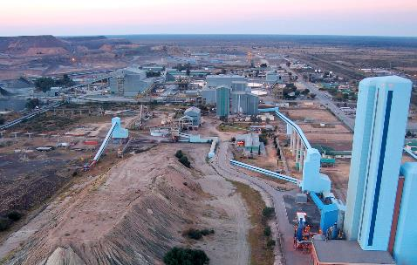
Debswana Diamond Mining Co. Ltd.
Orapa and Jwaneng, Botswana
Goals
    Provide real-time production and performance information
    Facilitate the more effective use of plant information More refined
    performance indicators
    Better optimization of plant operations Improved allocation of resources
    at the Plant
Challenges
    Six-month project deadline
    Tight budget
    Modifying the existing IT infrastructure
Results
    ISA-95 standardized data structure
    Continuous availability of accurate, real-time reports
    Reduced manual capture of information
    Historical data is now available
    Central repository for all plant-related information
Industry: Metals, Minerals and Mining
Products: System Platform, Process Historian Client, Process Historian
“In my view, one of the most compelling aspects of the Plant No.1 project has been moving from manual capturing to automated data retrieval. This not only greatly reduces errors but also speeds up the delivery of accurate information. Now I no longer have to worry about ‘death by spreadsheet’. ”
Zwikamu Dubani, IT Analyst, Debswana
LEARN MORE

Slide 90

Hydro Aluminium Extrusion Deutschland GmbH Germany
Goals
    Reduction of energy costs through the accurate management of peak loads to prevent expensive consumption peaks effectively
    Counter measures by optionally switching off users and/or switching
    on power generators
    Unified visualization of existing building automation/control systems
Challenges
    High availability
    System openness
    Standardized interfaces
    Integration of existing systems
    Centralized data collection and analysis • Easy management
Results
    Centralized monitoring of consumption
    Reduction of peak loads by complying with fixed load limits
    Possibility of counter measures before peak load limits are achieved
    Quicker ROI by avoiding incalculable costs and/or reducing calculable costs
    Short project deployment time
    Limited training requirements as a result of easy management
Industry: Metals, Minerals and Mining
Products: System Platform, Process Historian, Device Integration Server,
InTouch HMI (Standard Edition)
“We were looking for an easy-to-use configurable system; System Platform turned out to be the ideal solution thanks to simple object creation, configuration and inheritance properties.”
Oliver Houbé, Software Department Manager, EMP Planungsgesellschaft für Prozeßautomation mbH
LEARN MORE

Slide 91
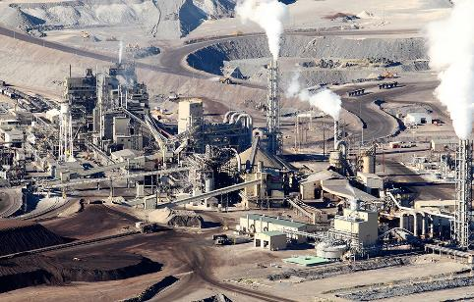
Lonmin Plc.
Marikana, South Africa
Goals
      Replace existing iFIX SCADA system with a modern, supported solution that would provide world-class technical and operational functionality
      Develop plant and company standards
Challenges
      Reconfiguring 300,000 I/O and redeveloping 530 SCADA screens without loss of production
      Prove the effectiveness of the chosen solution against all others
      and the ability of Lonmin to own the solution
      Tight time and budget constraintsConcurrent running of old and
      new systems
      Simultaneous development by multiple SIs
Results
      Enhanced performance
      Single set of standards
      Easier maintainability
      Superior reporting and delivery
      Fully-supported, constantly current software
      Ensured continued operation of production processes
Industry: Metals, Minerals and Mining
Products: System Platform, Process Historian
“In my view, the most outstanding features of this new system include the management of standards, its scalability and the ability to do development work on multiple fronts with multiple SIs simultaneously.”
Percy French, Automation Mgr., Lonmin Smelter
LEARN MORE

Slide 92
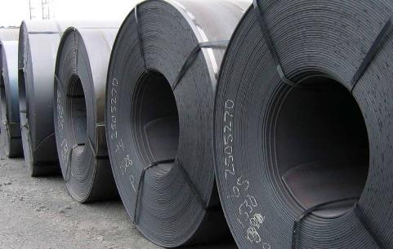
Nucor Steel
  Charlotte, North Carolina
Goals
    Make sure the steel plant is getting as much capacity as possible
    from the operation to solidify the market position of the company
Challenge
    Changes are implemented frequently to improve the
    manufacturing process
Results
    Continue to prtons of steel beams and girders in twenty different grades
    Elimination of downtime resulted in 2-5% increase in productivity
    Gain of 5-10oduce more than 2,500,000 tons of rolled sheet steel
    and 1,000,000 % in average voltage, which is directly proportional
    to productivity
    Before, it would take days to add a new piece of equipment to the control system, now it just takes a matter of minutes
Industry: Metals, Minerals and Mining
Products: InTouch HMI, System Platform, Process Historian, Process Historian Client
“I would recommend the Wonderware system to anybody who is looking for a way to improve their process, speed up programming changes and increase profits”
Dennis Boyd, Melting Area Electrical Systems Supervisor
LEARN MORE

Slide 93

Pretoria Portland Cement Co. Ltd. Pretoria, South Africa
Goals
    Replacement of legacy control system
    Establishing a centralized control room
    Ensuring the effective measurement of KPIs, logging and trending Installing
    a distributed PLC network
    Translating the old system into PLC / SCADA control
    Adding a new Process Historian server
    Replacing all redundant electrical equipment
    Installing new instrumentation
Challenges
    Replacing 30 years of control system evolution in five weeks while maintaining operations and mitigating potential interruptions
    Migrating operators who, for decades, have known exactly which button to push
Results
    Achieved PPC objectives within time and budget constraints
    Systems made best use of the existing PPC investment
    Operator buy-in, early ownership and easier change management through
    the ability to change the system to their liking cost effectively
    Standards based on best practices will facilitate future upgrades
    Four-screen design and navigation standard lets operators see
    everything at a glance
Industry: Metals, Minerals and Mining
Products: System Platform, InTouch HMI, Process Historian, Process Historian Client
“For the first time in a very long while, we feel that we are in control of one of our primary production processes. Even more than that, we are now in a position to improve operations through trustworthy real-time information and trends.”
Johan Saunders, Technical Advisor, Pretoria Portland Cement Co.
LEARN MORE

Slide 94

Richards Bay Coal Terminal Co. Ltd.
Richards Bay, South Africa
Goals
    New solution should solve plant concerns on manageability, cost effectiveness, security, reliability and accessibility
Challenges
    Old and new systems to run in parallel in order not to affect the performance of this colossal site
Results
    Reduced engineering cost on PC budget
    Improved software integrity
    Reduced power consumption
    Reduced likelihood of theft
    Reduced downtime on SCADA systems
    Increased end-user productivity
    Multiple connections possible to different servers creating redundancy
Industry: Metals, Minerals and Mining
Products: InTouch HMI, Process Historian Clients, Process Historian
“In my view, the most compelling aspect of this new thin client system is its scalability and versatility. It is vital for the system to be able to grow to meet business needs and to easily integrate with other systems.”
Eric Gumede, Control Systems Specialist, Richards Bay Coal Terminal
LEARN MORE

Slide 95

Roy Hill
Perth, Australia
Goals
    Build a green field iron ore mine, mine process plant, a heavy haul railway system from mine-to-port, new port facilities, and a Remote Operations Center
    Meet Roy Hill’s capacity of 55 million tonnes per annum
    (Mtpa) of iron ore
    Realize resource-to-market potential
Challenges
    Optimizing end-to-end demand chain visibility from the pit to
    the port across different time zones, from long term planning down
    to weekly scheduling
Results
    Improved efficiency by streamlining mining processes
    Increased collaboration among different functions
    Optimized resource-to-market opportunities with real-time execution
    Created a high performance team connected by a digitized process
    Provided key financial insights into production slowdowns and outages
    Established state-of-the-art Remote Operations Center (ROC) coordinating everything from mine to process plant to rail and port… from 1,300 km away from mine site
Industry: Metals, Minerals and Mining
Products: Demand Chain Planning and Scheduling (DCPS), Inventory Tracking and Quality Management (ITQM), Delay Accounting (DA), Capacity Simulation Model (Pre-CAPEX Analysis)
“We have a mine up in the Pilbara which is one of the largest mines in iron ore. We also have a processing plant and from there we have a 344-kilometer railway that takes the product through to our port operation where we load it onto ships at Port Hedland. So our mining operation is one of the largest in iron ore. We have an ore reserve of approximately 2.3 billion tons of ore. We will mine that at approximately one million tons a day and feed approximately 73 million tons per annum into our crushing facilities, which then gets turned into 55 million tons per annum of iron ore product.”
Mike Lomman, General Manager, Demand Chain Planning
LEARN MORE

Slide 96

Sibanye Group
Weltevreden Park, South Africa
Goals
    To better optimize plant operations and improve allocation
    of plant resources.
    To more effectively manage a wide range of disparate systems, including more than 2,000 PLCs, by establishing standardized methods
    To more efficiently manage energy usage
Challenges
    The company had a wide range of makes and models of equipment in place throughout its various Infrastructure with no centralized communication method
    Monitoring and controlling the company’s electricity usage was difficult due to the inability to acquire accurate reports
Results
    The mining company achieved effective centralized management of all equipment located at its Infrastructure in an 800km radius
    Sibanye now saves approximately 2MW a month in energy usage, which equates to more than $1.1 million per year in overall cost savings
Industry: Metals, Minerals and Mining
Products: System Platform
“Whether our operators are working at the Beatrix mine which is about 300 to 400 km away, they are able to view the same Wonderware SCADA application available to operators at all of our other mines.
Being able to view all operations simultaneously enables the Sibanye team to ensure mining processes are running smoothly and avoid unnecessary downtime.”
Jansen Van Rensburg, C&T engineer
LEARN MORE

Slide 97

South African Mint
South Africa
Goals
    To enhance production and enable material traceability management reporting and business efficiency
    To optimize inventory control
    To improve plant availability and overall equipment effectiveness (OEE)
    To reduce manual reporting and ensure data integrity through formal
    production accounting
Challenges
    The lack of detailed process information made it difficult to assess production information accurately
    With a host of disparate systems in place, it was difficult to effectively manage processes
    The existing infrastructure was outdated and could no longer be supported by the original vendor
Results
    Achieved accurate production and performance reporting
    Successful implementation of OEE reporting to optimize plant
    availability and performance
    Improved inventory optimization
    Plant floor equipment and processes now integrated with other
    systems including ERP
Industry: Metals, Minerals and Mining
Products: System Platform, Process Historian, InTouch HMI (Standard Edition), Enterprise Asset Management
“In my view, the most outstanding features of the Wonderware suite of MES and intelligence solutions we adopted were their ease of use, ease of integration and ease of maintenance.”
Lungile Binza, CIO, South African Mint Company Ltd.
LEARN MORE

Slide 98

Special Metals Wiggin - A PCC Company
United Kingdom
Goals
    Energy Monitoring
    Targeting
    Saving
Challenges
    Reduce Energy use through accurate comparison with production data
    Develop Energy per unit (tonne) trends through accurate correlation of energy and production data
    Report environmental data.
Results
    Energy reduction
    Payback within one year
    Accelerated Insight
    Good relationships with Environmental Authorities
    Accurate data for energy tariff negotiations
Industry: Metals, Minerals and Mining
Products: Process Historian, Process Historian Client, InTouch HMI
(Standard Edition)
“Wonderware Process Historian was the key breakthrough in making our data available as useful information to us...”
John Powles, Utilities & EMS Manager, Special Metals Wiggin
LEARN MORE

Slide 99

Westshore Terminals Limited Partnership
Delta, British Columbia, Canada
Goals
      Increase material handling efficiency
      Upgrade existing legacy system
      Improve access to data to mitigate risk
      Create a state-of-the-art data playback system
Challenges
      Existing legacy system had reached end of life
      Previous system required custom programming for database creation, yet even then, the database lacked the level of detail required and flexibility
      Transitioning the facility with zero downtime
Results
      Coal ships regularly go to 24 countries and the solution helps bring more than $2 billion of wealth to Canada each year
      The solution helps in handling of coal that accounts for about 30%
      of all tonnage through the Port of Vancouver
      Solution helps with maintaining throughput capacity of up to 29 million
      tons annually
      Increased access to data, greater collaboration that brings
      improved productivity
Industry: Metals, Minerals and Mining
Products: Process Historian Client, InTouch HMI (Standard Edition),
System Platform
“When it came down to it, what we wanted to ensure is we had a solution with the right technology that would last another 15 years. We selected Wonderware.”
John Newton, Process Engineer
LEARN MORE

Slide 100

Power and Utilities
100

Slide 101

9REN Group
Madrid, Spain
Goals
    The company needed to increase the production levels of its renewable energy generation installations in Europe
    9REN wanted to reduce its field operations maintenance costs by minimizing manual supervision of plant operations
Challenges
    Geographic dispersion of the company’s power generation sites throughout Spain and Italy demanded a centralized approach to system monitoring across differing time zones and weather patterns
    9REN required a solution that could easily scale with the projected installation of new renewable energy Infrastructure in new regions
Results
    Monitoring technology that provides instantaneous information from all photovoltaic plant installations has considerably reduced the cost of 9REN’s field operations
    9REN improved company profitability and power availability from its
    renewable energy plants, and reduced maintenance costs by limiting
    the need for on-site control
Industry: Power and Utilities
Products: System Platform, InTouch HMI (Standard Edition)
“9REN has improved the availability of this system using the very reliable solution from AVEVA. If you want to offer the market a better solution, you need to use an up-to-date monitoring system. AVEVA gave us this capability.”
Francisco Alija, Monitoring and Control Manager, 9REN Group
LEARN MORE

Slide 102

Bermuda Electric Light Company Limited Bermuda
Goals
    Provide reliable electric power to the entire island chain
    Deploy new capabilities and integrate new equipment self-sufficiently
    Attain ISO 14001-2004 certification
Challenges
    Bermuda’s remote location in the Atlantic Ocean means that
    in-person support is not quick to arrive and sometimes not possible
    Island development will require increased power generation
    in the future
    BELCO was attempting to be the first organization in the territory
    to achieve ISO 14001:2004 certification
Results
    With the help of the Wonderware software, BELCO’s generating
    plant and transmissions and distribution system provide consistent electricity to the 65,500 residents and 465,000 tourists who visit Bermuda each year
    BELCO achieved the prestigious ISO 14001:2004 certification for environmental management, in part because of the data collection
    and reporting capabilities of the Wonderware Process Historian and
    Wonderware Mobile Operator Rounds
Industry: Power and Utilities
Products: System Platform, InTouch HMI
“The major advantage we’ve experienced is that it’s very easy to develop and integrate the Wonderware software with the wide variety of equipment we have here. Plus their support is global and very timely.”
John Blizman, Vice President, Plant Management
LEARN MORE

Slide 103

Federal Electricity Commission (CFE)
Hermosillo, Mexico
Goals
    Implement diverse information technologies and telecommunications
    like graphical systems, and SCADA Systems that involve mobile
    workforce operations
    Centralize visibility and control over 38 transmission substations and
    140 sub-transmission substations throughout Northwestern territory
    Generate, distribute and market electric power for almost 35.3 million customers and roughly 100 million people throughout Mexico and bordering nations
Challenges
    Respond to and comply with governmental energy reform standards
    Structure its assets, workforces and operations to align with the Smart Grid
    Maturity Model (an international policymaking standard)
Results
    Orchestrated dynamic energy transmission models in real time
    Archived maintenance data to monitor asset health
    CFE making predictive decisions, mitigating risks and reducing costs
    Punctually identifying technical features traditionally handled on an SAP system
    Integrated Mobile Operator Rounds with its SAP system to more effectively and transparently view energy assets, and share real-time information with its mobile workforces
Industry: Power and Utilities
Products: Workflow Management, Intelligence, Mobile Operator Rounds
“The main benefits of these are that we have information in real time. We can make predictive decisions, mitigate risk, and reduce costs… We have calculated a rate of return on investment. For every dollar we invest, we can recover up to $10.”
Judas Salcedo, Head of Regional Department of Control CFE, Northwestern Transmission
LEARN MORE

Slide 104

Datang Power
  Datang City, China
Goals
    To help China’s plan of reducing energy consumption by 20%
    Expand plant capacity by constructing two new power generating units
Challenges
    Increase energy production while implementing energy-saving measures
    Lower costs of production while adjusting to fluctuating market conditions
Results
    The solution helps provide 600 MW of additional power to Shanxi province
    Significant cost savings realized via resource and performance optimization
    Faster load-following capability through adaptive, non-linear, multivariable coordinated control
    Improved asset reliability and reduced maintenance costs
    Maximize asset return of investment of asset by balancing the availability and utilization of equipment, energy, fuel optimization and improvement
    Improved plant availability and greater production efficiencies
Industry: Power and Utilities
Products: System Platform, InTouch HMI (Standard Edition), Process Historian, Process Historian Client
“AVEVA Operations Management has been an important partner, offering us a cost-effective process control solution and has helped to sharpen our competitive edge.”
Mr. Jinjian, Operations
LEARN MORE

Slide 105

Eskom Holdings Ltd.
  Johannesburg, South Africa
Goals
    Standardizing all power generation Infrastructure on a
    single software solution
    Enhance capture of plant information for better plant optimization and
    resource allocation
    Deliver better information in real-time for more effective
    operations management
Challenges
    Each plant operated its own control and operational systems,
    no standard in place
    Effectively merge IT systems to handle both transaction
    and plant information
    Make masses of plant-level data as usable information.
Results
    Established a standard software platform across all power plants
    Centralized data acquisition enabling authorized staff to access and
    use for daily job performance
    Successfully linked IT and the plant floor operations to effectively collect and assess data to make critical business decisions
    Improved overall plant performance and incident response capabilities
    Solution enables company to maintain ISA-95 standard
Industry: Power and Utilities
Products: Process Historian, Process Historian Client,
InTouch HMI (Standard Edition)
“Wonderware software provides our engineering and management teams with access to usable data that before was not readily available. We can now make decisions in real-time on our electricity generation capabilities, enabling Eskom to continue to improve the quality of life of more than 50 million people.”
John Viljoen, Corporate Consultant for Generation Business Eskom Holdings Ltd
LEARN MORE

Slide 106

Eskom Lethabo Power Station
  South Africa
Goals
    Install simulation system to help boost safety, efficiency and profitability at the plant
Challenges
    Improve productivity and plant operations, while increasing operator plant understanding, safety and reducing operating costs
Results
    The simulation system has reduced operating costs, while plant understanding and personnel safety have improved
    Assists in providing continuous electricity to 95% of South Africa (around 60% of the total electricity consumed on the African continent)
Industry: Power and Utilities
Products: InTouch HMI (Standard Edition)
“Simulation Platform delivered the Simulator on time and to budget. We are completing our training program on the Simulator and have been amazed at how easy the system is to learn and work with.”
Abrie Venter, Eskom Training Manager
LEARN MORE

Slide 107

GenOn Energy
  New Florence, Pa
Goals
    GenOn Energy needed to develop a training program to enable the easy transfer of technical knowledge and real-world experience from veteran power plant operators to new trainees in the shortest possible time period
    The company required a training solution that could deliver a high-fidelity model of the Circulating Fluidized Bed (CFB) waste coal-fired
    combustion process
Challenges
    New equipment and upgrades required the testing of alternative
    procedures and processes, which needed to be conducted without
    impacting live plant operations
Results
    The simulator is successfully being used to qualify new trainees and simulation training has standardized responses to specific problem or
    error conditions
    All control changes are first made and tested on the simulator before implementing on the plant, improving operational efficiencies and adding higher levels of confidence to control room management
Industry: Power and Utilities
Products: DYNSIM Dynamic Simulation
“The AVEVA solution has helped us significantly, that’s the pure dollars and cents of the project. But there’s also been quality of life improvements regarding overtime for the control room operators.”
Alan Metzler, Operations Manager, GenOn Energy’s Seward Generating Station
LEARN MORE

Slide 108

Intermountain Power Service Corporation Delta, Utah
Goals
    Replace the existing simulator as part of a DCS upgrade project
    to help prepare operations for the new user interface and
    control logic changes.
    New simulator to replicate the actual dynamic response of the operations and without any significant loss of megawatt production.
Challenges
    Validate the control logic against actual operations
    Build operator knowledge and confidence in the new DCS
    prior to going online
    Eliminate unplanned downtime or emergency shutdowns
Results
    Validated control logic and identified and fixed critical errors
    prior to going online
    Controls placed in automatic within 24 hours of start-up after
    DCS Upgrade
    Avoided potential losses to plant due to shutdown estimated at $1,000,000 a day
    Assists in maintaining a constant plant output of 13 million megawatt (MW) hours a year
Industry: Power and Utilities
Products: DYNSIM Dynamic Simulation
“The simulator paid for itself as a result of the DCS-Checkout alone.”
Bill Morgan, Project Manager on DCS Project
LEARN MORE

Slide 109

Portland General Electric
Portland, Oregon
Goals
    Supply ample and affordable power to 2 million residents of Portland
    Create reliable solution that can be reused throughout the plants owned and operated by Portland General Electric
Challenges
    Megawatt cost skyrockets when there is power shortage from the grid
    Find a way to have an efficient and optimized plant with less emission
Results
    Dispatchable Standby Generation (DSG) links 32 generators at 21 customer sites ensuring grid reliability at peak power demands.
    Improved efficiency of customer generators
    The system has enabled PGE to avoid buying wholesale power from the Western grid when prices are skyrocketing
    The system provide distributed real time monitoring, live video camera feed and an alarming system based on the IEEE-61850-420-7 object standard for all the sites
Industry: Power and Utilities
Products: Process Historian Clients, InTouch HMI, System Platform
“The Wonderware solution is working great. To my knowledge there are no other utilities in the world that have the ability to start 40 megawatts of paralleled power generation located at numerous customer sites with a single mouse click.”
Mark Osborn, PGE Distributed Resources Manager
LEARN MORE

Slide 110

PT Indo Matra Power
  Jakarta, Indonesia
Goals
    PT Indo Matra Power required an easy-to-use software portal that would enable engineers to run the plant more effectively and efficiently
    Access accurate, real-time data and enable trending, tracking and reporting of downtime to meet government compliance mandates
    Implement the project within a short timeline and on a small budget
Challenges
    Unplanned downtime was negatively impacting the plant’s compliance with regulatory requirements as well as affecting customer trust
    Plant engineers needed an easier and faster system for tracking production KPIs and scheduling maintenance and downtime.
Results
    The operations department is meeting production targets more consistently due to better accuracy of data, which is now received in real time
    Unplanned downtime is practically eliminated, so customers are happier and the plant is achieving compliance Goals
    With improved ability to analyze trends, the plant is benefitting from cost reductions, increased output and lower fuel consumption.
Industry: Power and Utilities
Products: Process Historian Client, Process Historian,
InTouch HMI (Standard Edition)
“We chose Wonderware because it has the most extensive features of all the products we tested. In addition, the support is excellent. This is important as the power plant location is in Indonesia.”
Berman Immanuel Purba, Operations and Maintenance Manager, PT Indo Matra Power
LEARN MORE

Slide 111

Salt River Project
Phoenix, Arizona
Goals
    Improve the performance of the Santan and Navajo plants by reducing the number of alarm floods
Challenges
    Reduce the increasing number and frequency of occurring process alarms while keeping the power plant safe and profitable
Results
    Implementing the alarm system design at the nine Santan units dramatically reduced the frequency of alarms. Plant startup previously took two operators up to four hours to complete can now be performed by one operator in less than two hours
    New system resulted in a 44% reduction of configured alarms
Industry: Power and Utilities
Products: Simulation Platform
“Now we have valid alarms that mean something to operators so they can respond appropriately. This increases efficiency and reliability. Operators now see the alarm system as a tool they appreciate, instead of a necessary annoyance.”
Ron Bewsey, I&E supervisor and I/A administrator
LEARN MORE

Slide 112

SEIC
Sakhalin
Goals
    Implement a database that allowed for full transparency
    Mitigate contractual risk
    Comply with anti-bribery and corruption rules
    Challenges
    Outdated contract management system
    In the early stages of two major expansion projects.
    Results
    Sakhalin Energy used AVEVA ProCon on the Sakhalin 2 project, established in 1994 to develop the Lunskoye and Piltun-Astokhskoye license areas. Shareholders on the project were Gazprom, Shell, Mitsui, and Mitsubishi
    Contracts are streamlined and accounted for
    Growth is closely watched
    Contracting and procurement process are systemised and codified
Industry: Owner Operator
Products: AVEVA ProCon
“AVEVA ProCon has taken us from being good at what we do to being great! The ability to understand and control our activity has grown enormously due to the implementation of this powerful contracts management solution from AVEVA.”
Employee, Sakhalin Energy Investment Company, Ltd.
LEARN MORE

Slide 113

Southern Mississippi Electric Power Assn. Hattiesburg, Mississippi
Goals
    Improve heat rate and boiler efficiency while maintaining low
    NOx emissions
Challenges
    Reduce the increasing number and frequency of occurring process
    alarms while keeping the power plant safe and profitable
Results
    Expected heat rate improvements of 1.5% , providing a project
    payback of less than one year
    Expert System at soot blower maximizes heat transfer area in
    the furnace
    Model Predictive Control provides increases boiler efficiency
    while maintaining steam temperatures and remaining within
    NOx specifications
Industry: Power and Utilities
Products: Simulation Platform
“Depending on the load, potential heat rate improvements up to 1.5% are expected. This benefit will provide a project payback of less than one year.”
LEARN MORE

Slide 114

Tata Power
India
Goals
    Avoid asset failures and reduce equipment downtimeIdentify subtle changes
    in system and equipment behavior
    Gain advanced warning of emerging equipment issues
    Monitor the health and performance of critical assets fleet-wide in real timeImprove maintenance planningEnable knowledge capture to optimize information sharing between plant personnel
Challenges
    Reduce unscheduled maintenanceMove from reactive to proactive maintenance
    Quickly analyze large amounts of asset data for accurate equipment condition assessments
    Information sharing between groups to get the right information to the right people at the right time
    Complexities in the process and technology of Tata Power fleets
Results
    Early warning identification of equipment problems, days weeks or months
    before failure
    Dynamic insights and deep-dive diagnostics for equipment behavior changes
    Improved equipment reliability and performance
    Better maintenance planning and cost control
    Knowledge capture of equipment failure modes
Industry: Power and Utilities
Products: Enterprise Asset Management
“We found AVEVA to be an effective tool in the predictive diagnostics space for detecting functional deviations and impending failures at an early stage for initiating suitable prioritized maintenance actions for enhanced reliability of critical power plant equipment.”
Praveen Chorghade, Chief - Core Technology and Diagnostics, Tata Power
LEARN MORE

Slide 115

Vectren Corporation
  Evansville, Indiana
Goals
    Eliminate inefficiencies in scheduling maintenance
    Track completed work
    Reduce operations, maintenance, and capital spending
Challenges
    Reduce overall operations, maintenance and capital spending, while maintaining high availability within plants and continuously and efficiently serving customers.
Results
    Supplies continuous and efficient power to two-thirds of Indiana and 16 counties in Ohio
    Enabled management to capture and analyze data about
    maintenance work.
    Efficiently tracks 6,000 unique assets and more than 33,000 individual spare parts, keeping track of work orders and labor time
    Ascertains key performance indicators and benchmarks throughout the maintenance operation
Industry: Power and Utilities
Products: Enterprise Asset Management
“Being able to track info about planned and unplanned work was one of the key performance indicators we were trying to improve on. Because of the way AVEVA interfaces with the workforce time-tracking program, we are able to get to this data much more easily.”
David Reherman, Reliability Engineer
LEARN MORE

Slide 116

Weldwood of Canada
  William Lake, Canada
Goals
    Enhance production efficiency with new computerized maintenance management system
Challenges
    Update outdated management system did not integrate the maintenance functions with plant purchasing systems, which required larger inventories of spares to be on hand
Results
    Diverse operations in both type and geography are now tied together
    Enhanced productivity through more efficient maintenance activities, helping to produce nearly 230 million square feet of plywood each year
    Achieved ISO 14001 certification at Williams Lake
Industry: Power and Utilities
Products: Enterprise Asset Management
“Many spare parts are no longer inventoried, but are simply ordered when a repair is scheduled and its work order is cut — which is a new capability that we gained, since the new system combines both work scheduling and parts purchasing.”
Hank Dickey, Maintenance Superintendent
LEARN MORE

Slide 117

Oil and Gas
117

Slide 118

ADNOC
Abu Dhabi
Challenges
    Long cycle to produce production plans, inconsistency in reporting, location performance and discrepancy in transfer measurement between plants
    Solution and Benefits
    Integrated Production Monitoring Platform, Performance Manager, Yield Accounting, System Platform and Historian
    Reduce “value leaks” and improve enterprise awareness with drill down on operations, equipment benchmarks, health and safety, energy usage, and production information
    Value optimization - macro and capacity planning with forecasting and What-if analysis of key inventories
    Information on cost/barrel as it moves through value chain
    Results
    Command Center integrates around 100,000 tags and aiming for more than 2 million Tags
    Panorama provides access information from one central location, enabling a “single version of the truth” via dashboards viewable from Pods and the 150ft x 10ft video wall centerpiece
    “Systematic Anticipation” a standardized, automated way of managing the business by looking at current and near future operations requirements, planned and actual performance
    Next: predictive analytics, decision automation and AI
Industry: Oil and Gas
Products: Wonderware System Platform 2017, InTouch OMI
“The Panorama Digital Command Centre demonstrates how ADNOC is utilizing cutting-edge technology to find new ways to optimize our assets, unlock value and drive efficiencies across the company. It provides a single access point to critical operational and performance information, facilitating smarter and faster decision-making and better enabling us to uncover new solutions.”
H.E. Dr Sultan Al Jaber, ADNOC Group CEO
LEARN MORE

Slide 119

Bluewater
  Hoofddorp, The Netherlands
Goals
    To replace and upgrade the existing integrated control and safety systems
    To achieve ‘First Oil’ on time in order to avoid contract penalties
    and lost production
    To maximize the availability/uptime of the control and safety systems and to minimize the total cost of ownership
Challenges
    The Project teams are located in multiple locations, that is, the Netherlands, Slovakia, Germany and SingaporeProcess data from the new ICSS, including serial interfaces, safety systems and new I/Os, were available only in the very late stages before the planned FAT
    The original DCS had to be kept ‘alive’ as long as possible and the
    existing safety systems had to remain operational with just a few hours available to upgrade
Results
    After replacing the Emerson ProVox and Delta V DCS systems and implementing a new integrated control and safety systems on the Glas Dowr, Bluewater was able to successfully meet ‘First Oil’ date on time
    Bluewater and its customer can now monitor the control and safety systems, both on and offshore, in real time Increased end-user ctivity
    Multiple connections possible to different servers creating redundancy
Industry: Oil and Gas
Products: Triconex® Control Simulation, Process Historian, Process Historian Client, InTouch HMI (Standard Edition)
“The Glas Dowr Kitan project has been a tremendous success for all parties. We were impressed with the AVEVA attitude throughout the project and their ‘change the game’ approach. It is one thing to have a good project plan in place, but another to actually execute and deliver.”
  Ernest Hofstee, Senior Project Manager, Bluewater
LEARN MORE

Slide 120

Borealis Group
Austria
Goals
    Create an automation system that will reduce risk, lower production costs and address all environment and sustainability Goals
Challenges
    Be able to check static equipment such as piping and pressure vessels Be able to evaluate the functioning of safety systems designed to prevent damage to man and/or the environment
Results
    An optimal safety systems was completed with less cost that inventing in traditional sensors
    Preventive maintenance are scheduled effectively
Industry: Oil and Gas
Products: System Platform, Mobile Operator Rounds
“The implementation of the Mobile Operator Rounds system cost less than 100.000 euro in total. That is not more than we would have needed if we had chosen to connect only 10 sensors to our DCS. If the new system will prevent a standstill of only one day of our factory, we will have earned enough to repay the investment.”
Wouter Verheyden, Reliability Team Leader at Borealis
LEARN MORE

Slide 121

Chevron
  San Ramon, California
Goals
    Chevron wanted to improve refinery performance and reliability, reduce maintenance costs, and simplify regulatory compliance. It was also eager to document the knowledge of workers approaching retirement.
Challenges
    The refining industry is driven by tight margins, and oil companies are constantly looking for ways to boost efficiency and reduce costs
Results
    Improved refinery reliability
    Reduced costs
    Better knowledge retention
    Improved regulatory compliance
Industry: Oil and Gas
Products: Mobile Operator Rounds
“Using Mobile Operator Rounds to accelerate and sustain process improvements, Chevron has reduced maintenance costs, improved availability, and achieved cost effective regulatory compliance.”
Mike Brooks, Global Refining IT Adviser, Chevron
LEARN MORE

Slide 122

Chevron Oronite Company LLC
  Gonfreville l’Orcher (Le Havre), France
Goals
    Implement a SCADA system for a new additive production unit
    Facilitate information sharing between shop applications and the SAP ERP application
    Use thin clients to connect to the SCADA servers
    Determine standards that make it easier to reuse and
    update applications
Challenges
    Adding different types of equipment to the ERP application
    Standardizing current terminology
    Meeting very short implementation deadlines
    Adopting the ISA-95 standard to define data sharing between the shop floor and the ERP application.
Results
    Information sharing between the ERP application and production units no longer requires manual intervention
    Launching a new product and adding new items is handled without jeopardizing the existing product
    Modifications to an object are immediately transferred to all of the graphic displays, resulting in significant time savings
Industry: Oil and Gas
Products: InTouch HMI (Standard Edition)
“We were looking for a SCADA system that would be easy to connect to our ERP application and we also wanted to implement the ISA-95 standard. The Wonderware System Platform met our expectations.”
Serge Talleux, Industrial IT Director
LEARN MORE

Slide 123

Infineum
  Vado Ligure, Italy
Goals
    Increase plant’s availability by anticipating any potentially
    damaging situations
    Optimize operators’ efficiency and reliability during inspection activity
    Limit production downtimes to scheduled maintenance only
Challenges
    The proximity of the plants to inhabited areas makes it essential for the sites to be safe and reliable at all times
    Detection of critical indicators, e.g. vibrations or the presence of foreign particles, which automatic instruments do not usually detect effectively
    Maximize the value of the time and experience of the field operators
Results
    The Wonderware solution has enabled the plant to achieve a plant availability factor of over 90%
    The system has allowed the operational procedures for visual inspections
    of equipment to be optimized and standardized, thanks to the removal
    of paper reports
    Wonderware Mobile Operator Rounds features now allow operators to identify potential problems which were previously neglected, thus avoiding the need for any emergency intervention
Industry: Oil and Gas
Products: Mobile Operator Rounds
“Using IntelaTrac has made a major contribution to reaching a plant availability factor above 90%, since it has integrated perfectly with the other innovations added to our equipment.”
Mauro Tassistro, Applications Team Leader
LEARN MORE

Slide 124

Kuwait Oil Company
Kuwait
Goals
    To ensure the safest oil refining operation by using the latest in 3D simulator training technology
    To effectively train both field and control employees to address refinery tasks quickly and efficiently
    To capture and knowledge-transfer best practices to new employees to increase efficiency and reduce operations and maintenance costs
Challenges
    The company established new more extensive training requirements for
    its employees
    Kuwait Oil’s aging workforce required the successful transfer of knowledge to its new generation of plant operators
    Management needed to maintain efficient production while at the same time ensure worker safety and competence
Results
    EYESIM helps the company to prepare new operators even before they step into new working environments
    Kuwait Oil can now better execute efficient training for its field and control room operators by means of a High-Fidelity Process Simulation coupled with a Virtual Walk-through Plant Environment3D visualization training using EYESIM enhances safety resulting in fewer accidents, which avoids costly plant shutdowns
Industry: Oil and Gas
Products: Simulation Platform
“The Simulation Platform helps in plant safety and combined with Smart Training supports the efficient overall operation of the refinery.”
Jamal Abdul-Hameed Al-Humoud, Manager, Research & Technology Group
LEARN MORE

Slide 125

PML Exploration Services
North America
Goals
    Provide a cloud-based solution with Web-based applications
    to provide real-time information
    Enable customers to have ready access to critical data, even
    while in remote locations
    Efficiently translate application user interfaces and reports
    into other languages
    Challenges
    The company established new more extensive training requirements for
    its employees
    No systems in place to provide current information to the wellsite
    Delays were as long as 12 hours between the actual analysis and reports provided to customers
Results
    Well drilling operations can enact changes based on real-time data that will help meet safety codes and protect integrity of the well
    The cloud-based solution provides customers with both time
    and cost savings
    The solution provides geosteering of the rock bit ensuring the client’s wellbore is accurately and safely placed
Industry: Oil and Gas
Products: Intouch Machine Edition
“InTouch Machine didn’t require us to write code for cloud-based technology from scratch, it was all right there in the software. This allowed us to put the information directly in the hands of the customer by providing a good Web solution.”
John Parsons, President & CEO, PML Exploration Services
LEARN MORE

Slide 126

TekSolv
United States
Goals
    To reduce the amount of time to deploy new projects
    To maintain highest level of environmental safety and engineering services
    To establish a technology standard that integrates all TekSolv applications
Challenges
    The multiple platforms and software products in place were not integrated and offered no technology standard
    Customers had to rely on stagnate or latent data to understand water levels or what fugitive emissions were present
    The safe and reliable collection of data in real-time information was difficult due to the remote locations of customer work sites
Results
    Deploying new projects now takes only a matter of minutes/hours
    instead of days
    The system’s object-oriented design facilitates significant cost savings
    in overall system programming and preserves the company’s
    technology investment
    Data can now be accessed from any device at any time from any location
Industry: Oil and Gas
Products: Mobile Operator Rounds
“In terms of ROI we look at man-hours, and the man-hours that we invested to deploy a new project now takes only a matter of minutes, maybe a few hours, rather than a few days.”
Jason Reed, Director of Information Technology, TekSolv
LEARN MORE

Slide 127

RasGas
Doha, Qatar
Goals
    Implement cost-saving measures to extend business efficiencies
    Expand production while maximizing existing technologies
Challenges
    Communication from on-shore control room to off-shore
    well is 130 km away
    Multiple operating platforms and hardware versions
Results
    World’s largest LNG supplier with expected total production
    of 77 million tons per year
    World’s longest safety system peer-to-peer network allows the
    onshore LNG system to shut-down the remote offshore wellheads
    from a distance of 130 km
    Provided lowest risk level and with the highest life cycle value
Industry: Oil and Gas
Products: InTouch HMI (Standard Edition)
“By working with AVEVA, RasGas is setting the pace for the LNG industry globally, supplying more efficient and more environmentally friendly energy for export to the world.”
Scott Pickens, Electrical Engineer Hanover
LEARN MORE

Slide 128

Western Refining
El Paso, Texas
Goals
    Improve management of maintenance and operations
    Efficiently track materials and work orders
Challenges
    Update aging legacy system to a modern windows- based maintenance management system, while reducing costs and improving efficiency
Results
    Scalable asset management to support company growth
    Familiar Microsoft Windows work environment Improved management
    of maintenance and operations
    Full accountability of work orders, labor, and materials
    Streamlined purchasing of materials and services
Industry: Oil and Gas
Products: Enterprise Asset Management
“Cost-value was the major factor in our decision to go with AVEVA. What also helped set the AVEVA solution apart was its use of Windows technology and its deep and growing relationship with Microsoft. This assured that employees could work in a familiar software environment and exchange data easily with other applications.”
Blake Larsen, Information Technology Manager
LEARN MORE

Slide 129

Water and Wastewater
129

Slide 130

Cairns Water
Australia
Goals
    Create an automated Water and Wastewater solution for the
    city of Cairns, Australia
Challenges
    An old and unsupported SCADA system had been used to control the Southern Treatment plant.
    Geography is a prominent factor with 40 pumping stations feeding into
    the central location
Results
    Helps in providing continuous water and wastewater services to the 145,000 people of Cairns, Australia. The Southern Treatment plant provides primary and secondary stages of sewage treatment for 60,000
    of the residents of Cairns
    Improved response times and provides better environmental compliance and monitoring
    Answered the priority need for continuous control, no matter where engineers are located
Industry: Water and Wastewater
Products: System Platform, InTouch HMI (Standard Edition),
Process Historian Software
“The most outstanding benefit with Wonderware on board right now has been the data collection process and our ability to trend it, produce reports and process issues much more quickly.”
Ted Ellis, Control Officer
LEARN MORE

Slide 131

City of Thunder Bay
Canada
Goals
    Create an ultra filtration system to purify the city of
    Thunder Bay’s Water
    Provide safe drinking water while protecting the environment
Challenges
    Expand the daily capacity from 14 million gallons to 25 million gallons
    Integrate the existing pumping station with the new plant equipment
Results
    ROI within two years
    Real-time reporting has enabled more effective regular maintenance for reduced downtime
    Historical trending reports have led to greater visibility and increased operational efficiencies
Industry: Water and Wastewater
Products: Process Historian Clients, InTouch HMI, Process Historian
“It’s very easy to use. I am able to pull whatever parameters I need into one trend and see how they’re related and make better-informed decisions.”
Michelle Warywoda, Process Engineer
LEARN MORE

Slide 132

City of Toronto
Toronto, Canada
Goals
    Increase and improve productivity, share maintenance information, reduce operating cost and improve customer service
Challenges
    Previous systems consisted aged preventive maintenance and inventory programs developed internally. Each facility had its own version of these programs and the functionality of those applications was very limited
Results
    Meets all of the EAM core functional requirements (work management, inventory, procurement)
    Management can determine accurately and quickly the costs
    of performing maintenance at water and wastewater
    operating Infrastructure
    The Division is identifying real savings by maintaining optimized inventory levels and improving replenishment procedures
    Ensures that the Water and Wastewater staff has readily available, accurate, and relevant information to help them be more effective in executing the work management process
Industry: Water and Wastewater
Products: Enterprise Asset Manager
“Overall, our staff is excited about AVEVA. They are impressed with the ease of use and speed with which information previously unavailable to them can now be acquired.”
Jim Coe, Program Manager
LEARN MORE

Slide 133

CRE-A Impresiones de Catalunya
Spain
Goals
    Keep the city’s 487,000 residents adequately supplied with clean,
    good-tasting water
    Provide safe delivery of wastewater to nearby
    sewage treatment facilities
    Challenges
    To ensure communication between the wide variety of existing plant machinery regardless of the communication protocols to be used
    To achieve production excellence in a pioneering facility of its kind, which was already achieving extremely high levels of efficiency
    Results
    "Total integration of information at both the production process level and with the company’s business system.
    CRE-A is today implementing better production planning and more efficient production management.
Industry: Water and Wastewater
Products: System Platform, Process Historian,
InTouch HMI (Standard Edition)
“Thanks to the full integration of production equipment, CRE-A now has useful, reliable and timely information available of its production process, which has facilitated the implementation of a work methodology based
on the philosophy of ‘lean manufacturing’, one of the main challenges
of the company.”
José Ramírez, head of industrial computers at SICMA 21
LEARN MORE

Slide 134

Eau de Paris
Paris, France
Goals
    Take into account video surveillance applications assigned to operators in charge of supervising water distribution Infrastructure
    Avoid overloading posted operators by multiplying the
    number of screens
    Display a large image containing relevant information
Challenges
    Integrate a detailed AutoCAD map of the water network
    into InTouch HMI
    Animate the InTouch HMI variables in this plan
    Automatically add video encrustations in the event of an intruder entering a site under surveillance
    Project the animated image obtained onto a large-dimension video wall
Results
    Operators have a global and detailed view of the installation, presented on a large dimension video wall
    Operators can keep their traditional stations with a screen and can also use the video wall to show relevant views, back-to-back in relation to the large animated block diagram
    User-friendly application, less stress for operators
Industry: Water and Wastewater
Products: InTouch HMI (Standard Edition)
“For 15 years, InTouch HMI has been supervising water distribution Infrastructure that provide water to 4 million people in Paris. This role has gained strength over the years. For a few months now, InTouch has been animating a large block diagram displayed on a video wall and steering video surveillance applications. This is a move from classic supervision to hypervision.”
Frank Montiel, Head of the Regulation-CTM project in the
Information Systems Dept., Eau de Paris
LEARN MORE

Slide 135

Global Water Management, LLC
United States
Goals
    Provide ample water and meet county, state and
    federal quality standards
    Use less power, conserve energy and operate more profitably
    Reduce operator time spent driving to remote locations to save fuel and vehicle costs
    Improve measurement of treatment processes and gather historical and real-time equipment data for better preventative maintenance
Challenges
    Aggressive timeline required the new system to be operational within
    a few weeks
    Operations cover a 100-square-mile territory with
    8 separate Infrastructures
Results
    The Wonderware software solution’s standardization and repeatability resulted in quick development time
    Historical data and trending reports now are available to management for improved decision making
    Preventative maintenance has extended equipment life; power use is minimized and operations are more profitable
    Remote visibility saves operator travel time and has improved efficiency while reducing fuel and fleet maintenance costs
Industry: Water and Wastewater
Products: System Platform, InTouch HMI (Standard Edition),
Process Historian Software
“…we can address problems before they occur. It’s the big picture we need to fine tune and solve complex problems.”
James Taylor, Operations Manager
LEARN MORE

Slide 136

Long Beach Water Department
Long Beach, California
Goals
    Keep the city’s 487,000 residents adequately supplied with clean,
    good-tasting water
    Provide safe delivery of wastewater to nearby sewage
    treatment Infrastructure
Challenges
    Solution is required for a complex water system consisting of nearly
    30,000 different data points at 85 major equipment sites
Results
    Solution resulted in an average annual return of $300,000 on the
    current investment
    Help operate and maintain nearly 765 miles of sewer lines, and deliver more than 40 million gallons of wastewater per day to Los Angeles County sanitation district Infrastructure
Industry: Water and Wastewater
Products: System Platform, InTouch HMI (Standard Edition), Process Historian Software, SCADAlarm Software
“With the new Wonderware system … we estimate an average annual return of $300,000 on the current investment.”
Ray Gonzales, Telecommunications Manager
LEARN MORE

Slide 137

Measuring and Predicting
Water Flows in Ølgod Denmark
Goals
    Select a cost-effective and long-term solution which can gather detailed information about pressure, retention time and flow directions of water at any point in the pipe
    Scale the process equipment appropriately to optimize
    and develop the network
Challenges
    Ølgod’s approximately 150 kilometers of pipeline is ring-connected, which meant it was not possible to know which way the water flows
    Operators had to access the physical pipe itself to place a special ultrasound device for a whole week in order to determine the direction and quantity of water for that particular pipe
    Visibility of Ølgod’s network was very limited, which meant it was difficult to scale the process equipment appropriately to optimize and develop the network
Results
    Ølgod is now able to trace the source of contamination, determine how far the contamination has traveled in the network and has the information to identify which consumers are affected and provide immediate warning via SMS to them
    Aquis eliminated the need of having to install numerous measuring wells which could cost around 7,000 Euros each, helping Ølgod achieve significant savings
    With visibility into the entire water network, planning of maintenance and expansion work on the network is now easier and more economical
Industry: Water and Wastewater
Products: Water Network Management
“Without a system like AVEVA’s, you are groping in the dark when it comes to assessing the dispersal direction of a contaminant or analyzing the source of contamination.”
Henrik Linding Jessen, Engineer at Ølgod Tekniske Værker
LEARN MORE

Slide 138

Ontario Clean Water Agency
Ontario, Canada
Goals
    Provide consistent high-quality water & wastewater treatment services
    Build in scalability and standardization to improve efficiency
    Control costs; do more work with fewer staff in less time
    Provide the highest levels of regulatory compliance
Challenges
    Vast service area; wide-ranging customer types and sizes
    Strict quality/compliance regulations must be met while delivering
    cost-effective service
    Provide continuity plus accommodate future technology integrations
Results
    Scalable; ideal for wide area installations and communications
    Adding new customers costs less and is accomplished in hours rather
    than days
    Increased location support without increase in staff
    Real-time reports have improved analysis and proof of compliance
    Changes required for regulatory compliance can be tested and deployed in one day
Industry: Water and Wastewater
Products: Process Historian Clients, InTouch HMI, SCADAlarm, System Platform
“The reliability we have with the Wonderware Historian is phenome nal. Because of the store and forward feature, it eliminates any loss of data. That’s critical to the whole system because we have to report that information to our regulatory body.”
Robert Simpson, Manager, Asset Management and Operational System Support, OCW
LEARN MORE

Slide 139

Pima County
Pima County, Arizona
Goals
    To ensure capture of institutional knowledge of current workforce for effective training of future operators
    To employ an effective Situational Awareness strategy enabling personnel to effectively understand and address operations of the facility
Challenges
    Management of more than 60 million gallons of sewage each day with assets spread out over more than 700 miles to support the region’s population of more than 1 million people
    To take immediate action when alarms sound alerting operators
    to issues within the plant
Results
    Capacity of the plant has doubled resulting in a 50% increase in
    operational efficiency
    Overall energy consumption has been reduced by 10%
    Current staff levels were maintained, while still achieving significant
    operational improvements
    “Institutional Knowledge” is captured to train future workforce, successfully addressing concerns of the facility’s aging workforce
    Sophisticated Data Mining capabilities resulted in the county receiving a $362,000 rebate check from the local utility
Industry: Water and Wastewater
Products: System Platform, InTouch HMI (Standard Edition), Process Historian, Process Historian Client, Mobile Operator Rounds
“The new Wonderware SCADA system has enabled our Tres Rios facility to double capacity, while operating using the same number of staff, which is about a 50 percent increase in operational efficiency with a 10 percent in energy consumption.”
Rod Graupmann, SCADA Manager, Pima County, Tres Rios Facility
LEARN MORE

Slide 140

Pinellas County
Clearwater, Florida
Goals
    Supply ample fresh water and provide wastewater treatment for 1 million citizens and 4.2 million visitors each year
    Meet or surpass federal and state drinking water-quality regulations
Challenges
    Replace the outdated SCADA system at PCU with a unified and centralized solution
    Create a system that will publish valuable realtime and historical plant information to the web or company intranet
Results
    Wonderware system saved 30 to 40 percent in time for editing and changing application screens resulting in engineering productivity and streamlined engineering time
    PCU programs have won numerous regional and national awards for innovation and effectiveness
Industry: Water and Wastewater
Products: Process Historian Clients, InTouch HMI, System Platform
“Wonderware InTouch HMI software for visualization and industrial process control was installed to allow workers at PCU to quickly create and deploy customized applications that connect and deliver real-time information.. ”
Ken Osborne, SCADA Systems Coordinator
LEARN MORE

Slide 141

Puerto Rico Water & Sewage Authority Puerto Rico
Goals
    Maintain high quality standards for EPA compliance
    Increase efficiency of management for one of the world’s largest system platform installations
    Enable better visibility and troubleshooting for over 1,500 sites
    Provide higher capacity output while controlling costs
Challenges
    More than 120 different platforms to be integrated
    Needed faster deployment of new installations
    Tough terrain with areas where radio and DSL communications
    can’t reach
Results
    Output has increased from 12 million gallons to 20-30 million gallons
    Cost savings estimated at $15 million over seven years
    Fewer shutdowns and improved customer satisfaction due to proactive trouble shooting
    Island-wide standardization for faster installations and increased operator ease-of-use
    Clean, EPA-compliant water
Industry: Water and Wastewater
Products: InTouch HMI (Standard Edition)
“Using Wonderware software has made this plant the role model for the Metro region. It has helped us improve and maintain the quality of the water produced in this facility – which is excellent!”
Nancy Caceres, Plant Manager-Guaynabo
LEARN MORE

Slide 142

Seminole County
Seminole County, Florida
Goals
    To implement a mobile process management system to ensure the safety of the more than 46 million gallons of water produced each day
    To enable field operators to access critical data via mobile devices for immediate decision-making onsite
Challenges
    Had to keep an operator 24 hrs. a day at a SCADA desk or waiting for
    alarms to come in and people called or paged out
    The County needed a better method to access data from the Process Historian and communicate it to operators in the field
Results
    Actionable data with alarm points that can now be accessed in the field on any type of mobile device to effectively manage the production of 46 million gallons of water each day
    Answers are provided to operators within minutes instead of a ½ hour to manage operations of Seminole County’s 10 Infrastructure
    Having real-time data accessible on mobile devices eliminates the need to have managers drive to a water plant to take care of an issue
    Operators receive alerts before alarms occur, enabling them to address an issue before it becomes a problem, and before the County’s 440,000 residents know there’s a problem
Industry: Water and Wastewater
Products: SmartGlance Mobile Reports
“The best part about the SmartGlance alerts, is that we get to the problem before it becomes a problem, and the residents of Seminole county never see a problem.”
Russell W. Carpenter, Technology Coordinator
LEARN MORE

Slide 143

Società Risorse Idriche Calabresi
Italy
Goals
    Increase the capabilities and efficiency of the main plant which supervises a complex regional aqueduct system
    Better measure water output and gather realtime data to more accurately identify waste
    Find a flexible and scalable platform to support the entire system
Challenges
    The enormity of the system and the geography of the area makes it difficult to accurately record the volume of water produced
Results
    Società Risorse Idriche Calabresi (So. Ri.Cal. S.p.A.) now monitors and controls a huge system with 200 aqueduct systems, four dams, 10 derivation crossbars, 14 wastewater plants, 300 lifting stations and almost 1,000 tanks
    The new Wonderware solution brings realtime data to operators in the central plant, allowing them to visualize problems on remote machinery and respond to them immediately and automatically
    Accurate data is being collected for reporting and analysis, which is valuable for current and future planning
    With the great success of the pilot program, the Wonderware solution will be implemented across the entire system; immediate ROI is expected
Industry: Water and Wastewater
Products: System Platform, InTouch HMI (Standard Edition) for Terminal Services,
Process Historian
“By the end of the test phase, the Wonderware solution will provide immediate ROI and justify our investment.”
Sergia De Marco, General Director, Società Risorse Idriche Calabresi
LEARN MORE

Slide 144

Southern Nevada Water System
United States
Goals
    Improve maintenance project and equipment status tracking
    Reduce inaccurate recordkeeping
    Increase employee performance
Challenges
    Automate the maintenance planning and scheduling system, reduce paperwork and free field technicians from costly, time consuming, and potentially inaccurate paper recordkeeping
Results
    In its first year of operation, expected savings is about $17,000
    in work order processing and $33,000 in reduced administrative costs
    More efficient work order processing and timely maintenance
    project tracking
    Improved accuracy in form completion, employee performance management and equipment status tracking
Industry: Water and Wastewater
Products: InTouch HMI (Standard Edition)
“In addition to eliminating paper shuffling, we avoid problems related to lost or inaccurately completed forms. We save cost of producing, filing, and sorting work orders, and we have better tracking of employee performance and equipment status.”
Jeffrey Deitch, Business Systems Analyst with the Technology and Special Projects Technology and Special Projects
LEARN MORE

Slide 145

Spokane Water Department
Spokane, Washington
Goals
    Transition from a limited-capacity system to a new, more scalable water management solution
    The new solution needed to enable operators to make changes and additions without outside technical assistance
Challenges
    The former SCADA system was limited to 48 sites and was not adaptable to Spokane’s growing needs
    Obsolete telemetry caused slow communications between the central control site and remote stations
Results
    The Upriver Dam generates over 70 million kilowatts of electricity annually, which is enough to power the water plant, contributing to the department’s sustainability efforts
    Lost water rates (measuring water wasted due to leaks, inaccurate metering or slow repairs) are at 6%, among the lowest in the nation
    The Wonderware system enables remote monitoring and control which has cut the frequency of travel to stations by about two thirds while saving on vehicles and fuel
    The redundant SCADA system guarantees uninterrupted operations for the City of Spokane, 24/7
    The solution’s scalable architecture and object based implementation empower in-house staff to deploy applications and perform changes without outside help
Industry: Water and Wastewater
Products: Process Historian Client, InTouch HMI (Standard Edition), System Platform
“The real value to us is that we have continuous monitoring and can identify problems more quickly. You have confidence that what the system is telling you is correct.”
Mark Cleveland, Operations Supervisor
LEARN MORE

Slide 146

Stadtwerke Dusseldorf (Public Works) Germany
Goals
    Fight increasing costs by uniting three waterworks plants under one automated control solution
    Bring reporting in-house, so staff can perform real-time evaluations, analyze trends and provide documentation for compliance
Challenges
    Before this project, there was no synchronization or coordination between the three plants
    There was no data collection or archive system in place
Results
    Operations are fully automated, resulting in reduced operating costs, increased plant productivity and availability, improved maintenance and simplified administration
    With the new AVEVA solution, data is centrally archived and secure; availability of real-time and historical data has enabled the City of Dusseldorf to meet its Goals for the system
    Operators and management have the data they need to quickly analyze and efficiently optimize processes
Industry: Water and Wastewater
Products: InTouch, System Platform, Process Historian, Process Historian Client
“Now we are able to create all required reports, analyses and documentation ourselves. We are no longer dependent on outside companies to provide us with that information.”
Matthias Rammler, Electrotechnical and System Support, City of Dusseldorf Public Works
LEARN MORE

Slide 147

Vaasan Vesi
City of Vaasa, Finland
Goals
    Upgrade to new automation and control software with capabilities to meet the needs of a growing, environmentally conscious city
    Create a new system that would be easy to maintain, provide excellent reliability and offer high availability of data
Challenges
    It was necessary to plan the upgrade carefully to ensure that there would be no shutdowns during the changeover
    Once upgraded, the new system also needed to anticipate problems and avoid future interruptions in operation
Results
    The City of Vaasa and its citizens are benefitting from a sustainable water and wastewater treatment solution
    The project was completed ahead of schedule with no shutdowns or customer complaints during the upgrade
    Management finds the Wonderware solution to be highly reliable and functional, easy to configure, change and expand
    The Wonderware solution architecture accommodates flexible remote connections to workstations throughout the city
    Back up and security levels for data have been achieved; clear controls and reporting are meeting management requirements
Industry: Water and Wastewater
Products: InTouch HMI, System Platform, Process Historian, Process Historian Client
“The advantages of the new system include reliability, functionality and clear control and reporting. The decentralized network structure and the capability to store large amounts of information allow high system availability and room for future expansion.”
Per-Eric Lindh, Instrument Technician,Vaasan Vesi
LEARN MORE

Slide 148

WaterForce
Goals
    To build a complete water management portal that would allow farmers to remotely monitor and control critical irrigation systems for increased operational efficiency, improved water and energy efficiency, and better compliance with regulatory requirements
    Maximize existing equipment and leverage cloud and IIoT technologies to deliver an always-up-to-date view of critical irrigation systems
Challenges
    Find a technology vendor that could help WaterForce build and deliver a scalable, robust, and futureproof IIoT solution covering everything from connected devices, control, and analytics
    Irrigation pumps and pivots are remote and isolated, so the cloud-platform has to deal with possible network outages and late-coming data
Results
    Increased visibility of irrigation system performance and status –
    for both farmers and WaterForce
    More efficient and effective water use
    Farmers report up to 50% reduction in energy costs in first season
    Remote monitoring means farmers save significant time driving to
    inspect assets
    As the solution builder (OEM), WaterForce can now offer additional
    value-add services such as fault diagnosis and performance benchmarking
Industry: Water and Wastewater
Products: InTouch HMI, System Platform, Process Historian, Process Historian Client
“Most farms are not built to handle large software installations. Using a lightweight, cloud solution with mobile capabilities has been key to expanding IoT capabilities to these farms. By leveraging our relationship with AVEVA, we can focus on our core business – effective water management – knowing that the information management, analytics and automation side is covered.”
Ron McFetridge, Director, WaterForce
LEARN MORE

Slide 149

Yellow River Conservancy Commission China
Goals
    Create a large-scale operating system including a central database,
    real-time information transference and processing, and decision
    support distributed
Challenges
    The scope of the installation is large as it occupies several
    thousand kilometres
Results
    The conservancy provides water to one hundred million people in nine Chinese provinces
    New system effectively regulates water quantity and prevent flow stoppages, particularly during droughts
    Solution helps Yellow River Commission staff forecast floods and create proactive flood progressing models
    Plant personnel can securely share information over the Internet, regardless of their locations along the lengthy Yellow River
Industry: Water and Wastewater
Products: System Platform, InTouch HMI (Standard Edition), Process Historian Software, Process Historian Client, Device Integration Servers
“I believe that with the expansion of this system, we can make the Yellow River more beautiful and younger, and bring more benefit to Chinese people along the Yellow River.”
Liu Xiaoyan, Director of the Water Regulation Bureau
LEARN MORE

Slide 150

Machine Builders / OEM
150

Slide 151

Azbil
Goals
    Implement a software solution aligned with the corporate mission to realize safety, comfort and fulfilment in peoples’ lives while contributing to the global environment through “human-centered automation”
    Take advantage of an off-the-shelf solution that offers quick deployment and ease of use
Challenges
    The corporation requires a software solution with enough versatility to interface with many different hardware systems worldwide
    With over $2.4 billion in global sales, Azbil needs extensive and immediate technical support
Results
    With the Wonderware software’s ability to support Azbil’s “Operation Anywhere” concept, the corporation has increased sales by approximately 50% over the last four years
    Wonderware software’s standardized, pre-built graphics have provided savings in engineering costs and development time
    Azbil customers are maximizing their existing system investments due to the Wonderware solution’s easy upgrades and upward compatibility
Industry: Machine Builders / OEM
Products: System Platform, InTouch HMI (Standard Edition), Process Historian Software, Process Historian Client, Device Integration Servers
“The terminal server capability of Wonderware software has enabled Azbil to increase sales by 50% over the last four years. ”
Hironobu Hirakawa, Development Manager
LEARN MORE

Slide 152

BSH Bosch und Siemens Hausgeräte Gmbh Germany
Goals
    Create an automatic equipment and operations data collection system that present equipment and operating data in charts, reports and dashboards
    Create a system that monitors downtime and scrap analysis and calculates Overall Equipment Effectiveness, measures variance and performance measurement (shift performance, cycle time, tooling, lost productivity data)
    Visualization of current parameters, tooling process and tooling optimization
    Enable automatic reporting and alarms via e-mail
Challenges
    The system has to be open, use a scalable platform on a unified enterprise-wide, multi language and web based system
    The solution has to run on a virtual and central server environment while being fully integrated to BSH’s existing IT environment
Results
    Elimination of manual annotations for OEE parameter collection, with significant time saving for plant staff
    Accurate and comprehensive records of plant status and events
    Extensive system implementation on a global scale
    Faster and easier access to parameters via BSH Intranet
    Identification of improvement actions
    Definition of key areas (tools, plants and processes)
    Valuable tool for purchase decisions (e.g. identification of scrapped purchased parts percentage or equipment downtime due to defective parts
Industry: Machine Builders / OEM
Products: Manufacturing Execution System, System Platform, InTouch HMI (Standard Edition) for Terminal Services, Process Historian, Process Historian Client
“The elimination of manual operations for the measurement of OEE parameters has resulted into significant cycle time reduction. Based on the results achieved with this solution, we are considering its extension to other countries outside Europe.”
Andreas Busse, BSH Bosch and Siemens Hausgeräte GmbH,
IT Product Lifecycle Project Manager
LEARN MORE

Slide 153

Daifuku Co., Ltd.
Japan
Goals
    Provide best-in-class, comprehensive materials handling and logistics solutions to companies worldwide
    Achieve higher efficiency with software that supports
    multiple languages
Challenges
    Daifuku required a solution that would be flexible for global customers and also enable high productivity
    As a large business serving companies throughout the world, Daifuku requires responsive, multilingual technical support
Results
    The Daifuku solution incorporating the Wonderware software provides an easy-tounderstand, intuitive overall view for planning and monitoring materials handling operations
    Because of its open architecture and support for multiple languages and character sets, the Wonderware software helps developers and engineers to be more productive
    The solution is highly flexible for use by Daifuku customers around
    the globe
Industry: Machine Builders / OEM
Products: InTouch HMI (Standard Edition)
“Daifuku uses Wonderware software as the front-end HMI providing Monitoring and Operation Support capabilities that enable users to have a complete picture of what is happening in the system.”
Yasuhisa Mishina, Deputy General Manager
LEARN MORE

Slide 154

Hendrick Motorsports
Charlotte, North Carolina
Goals
    Integrate Microsoft’s Business Solutions- Dynamics SL financial program into a single, compatible system to manage inventory, track parts usage, and maintain a historical profile of car performance
    within 4 months
Challenges
    Coordinating information across 6 warehouses that are operated as independent entities
    Tracking usage of approximately 150 components on each car
    Getting the system up and running within four months
Results
    Multi-site asset management capabilities tracks inventory
    in all six warehouses
    Reduced cash outlay for inventory saves $400,000
    Saved $1,000,000 through reduced inventory by consolidating warehouse management
    Reduced overhead for single instance, multifacility management and
    saved $65,000
    Integration with existing business and financial operations resulted in
    $100,000 savings
Industry: Machine Builders / OEM
Products: Enterprise Asset Management
“What AVEVA has accomplished with a single system could have required four separate systems. The AVEVA solution also allows us to collect accurate performance and maintenance information to make informed decisions…this is priceless.”
Scott Lampe, Chief Financial Officer
LEARN MORE

Slide 155

Ingersoll Rand
Ireland
Goals
    Reduce the energy consumption of manufactured equipment
    Optimize equipment management by end users
    Optimize compressed air consumption for customers
Challenges
    Adopt a software to control the proprietary equipment supplied by Ingersoll as well as by other vendors
    Identify the compressed air demand of production lines and, in some cases, also predict future demand
Results
    Compressors are turned on and off individually, using a smart management process based on actual requirements
    Real-time visualization of the status of installed equipment, eliminating the need for individual monitoring
    Monitoring of critical parameters to identify possible failure signals in advance, thus implementing real predictive maintenance
    Few months after the installation of the supervisory system, the end customer achieved approximately 8,000 Euro/ month of savings on the energy bill compared to the previous year
Industry: Machine Builders / OEM
Products: InTouch HMI (Standard Edition)
“A customer asked to integrate our control system with the Wonderware solution they were already using to manage their manufacturing process. As a result, we could appreciate the benefits offered by an established platform, featuring high reliability and well known across the industrial domain.”
Luca Ferrari, Energy Air Audit Specialist, Ingersoll Rand
LEARN MORE

Slide 156

Industrialesud S.p.A.
  Teramo, Italy
Goals
    Optimize the production changeover management and recipe
    management system
    Implement a system aimed at improving production efficiency
Challenges
    Guarantee continuous control with quality reference parameters
    Provide a reliable connection to corporate quality management systems
    and production data analysis
Results
    The system now complies with internal quality procedures while able to optimize the production cycle
    Production process automation eliminated errors due to manual updates by operators
    Increased loyalty of big customers because the new automated system provides better safety in each process stage while maintaining compliance with manufacturing conditions
Industry: Machine Builders / OEM
Products: Industrial Computers, Manufacturing Execution System,
InTouch HMI (Standard Edition), Process Historian
“We have been using Wonderware solutions for years, as they provide effective answers to sophisticated requirements in the automotive industry, where this platform is recognized as a market leader. ”
Carlo Caramanico, Technical Manager, CMQ Automazione for Industrialesud
LEARN MORE

Slide 157

Italpresse
Capriano del Colle, Italy
Goals
    Develop an HMI that communicates with other devices
    and other platforms
    Incorporate AR/VR as an asset performance tool embedded
    within its presses
    To collect and historise plant data in a local SQL server database
    Support the company’s leadership position in Industrie 4.0.
Challenges
    Innovate a completely new revenue stream in the slow-moving aluminum foundry industry
    Leverage breakthrough AR/VR technology to introduce a new asset performance management solution
Results
    Delivering an open interface HMI architecture that communicates with
    other devices, collects data on a SQL server database, and improves
    situational awareness
    Reinventing the concept of HMI for the captive foundry industry
    Introduced a completely new remote support concept to captive foundry
    Expanded its Industry 4.0 commitment by developing an asset performance management solution based on AR/VR technology
Industry: Machine Builders / OEM
Products: Wonderware System Platform, Wonderware InTouch HMI,
AVEVA AR/VR Platform
“This is a digital transformation not only of our equipment but also of our business completely.”
Carlo Scalmana, President, Italpresse Gauss
LEARN MORE

Slide 158

John Bean Technologies
Italy
Goals
    Maximize plant productivity;
    Avoid production downtime;
    Prevent failures and maintenance operations during periods of peak production for customers;
    Adopt a standard HMI solution, which is reliable while easy to use;
    Full control of production parameters.
Challenges
    Final customer’s production process concentrated in few months;
    Impossibility to make software operation tests during production stages;
    Strict international regulations on traceability
Results
    Immediate action in case of failures or product anomalies
    Compliance with industry standards
    Full access to information for operators
    Competitive advantage in South East Asia thanks to InTouch interfaces in Chinese language.
Industry: Machine Builders / OEM
Products: InTouch HMI (Standard Edition)
“From the very start, Wonderware InTouch has proved to be very intuitive and easy to use, as well as highly reliable. These features encouraged us to adopt it as standard HMI across our new lines.”
Luca Bandini, Project Manager, SCADA Automation, John Bean Technologies
LEARN MORE

Slide 159

Magna Automotive
Burton-on-Trent, United Kingdom
Goals
    Magna Automotive was required to increase the number of panel variations to handle the requirements for both the outgoing and new vehicles, which meant an increase in the number of variances of around 17%.
Challenges
    The project had to be completed in a very short time frame.
    The plant could not be shutdown and production had to be maintained
    while the expansion was being undertaken.
    The new system had to show improvement in quality, throughput and
    space utilization.
Results
    New personnel can operate the plant with very little training.
    On time delivery.
    Productivity for the existing workforce increased equivalent to a head count redeployment of 8%.
    The Automation and Control System was enhanced by improving stock control, production planning, and inspection of stock produced, as well as adding advanced, automated reporting capabilities.
Industry: Machine Builders / OEM
Products: InTouch HMI, Wonderware System Platform
“By using upward-compatible, standard software from Wonderware, we were able – even in the first phase in 1996 – to lay the foundations for later expansions. There has never been a need for an expensive, time-consuming renewal of the InTouch application for version upgrades.”
Olaf Kolmer, Project Manager, Cegelec AT GmbH
LEARN MORE

Slide 160

Meteng Pty LTD.
Australia
Goals
    Enable an accelerated design process so that plants can begin to generate income more quickly
    Provide an interactive simulation environment that saves time and money by testing plants and processes before they are constructed
    Facilitate more effective learning by enabling operators to make mistakes
    and practice responding to emergency or out-of-compliance conditions without negative consequences
Challenges
    The complex Walk-Through Interactive Simulated Environment (WISE) system has enormous power requirements and integrates Apple, Windows and Wonderware technology with very large, high-resolution displays
    The system had to be built with components that would ensure easy and cost effective expansion to meet the needs of many different client
Results
    Improved system performance, increased data transfer rates and response to operator interactions on the various systems that make up the simulation system
    Developers could concentrate on task of process modeling and simulation instead of focusing on complex program code
    Software offered opportunity for Meteng to develop methods enabling re-use and standardization, resulting in tremendous savings in engineering costs
Industry: Machine Builders / OEM
Products: InTouch HMI, InControl Software
“We found enormous differences in data transfer and operator response rates with other systems, but we have not yet found any limitation on what we can do with Wonderware software.”
Jim Groutsch, Managing Director
LEARN MORE

Slide 161

Pavan Group
Italy
Goals
    Maintaining high efficiency on lines in continuous operation;
    Combining legislative requirements and production management;
    Providing operators with total visibility on production lines;
    Graphically displaying production line maintenance requirements.
Challenges
    Using the same machines for different products and formats;
    Compliance with EU directives on traceability;
    Quicker changeover;
    Quick and simple configuration of each new production batch by the operator
Results
    The end customer can immediately trace back to the causes of any performance reduction;
    Competitive advantage stemming from a range of machines and systems equipped with innovative tools and instruments for real- time automation and data management;
    Reduced energy consumption thanks to optimized production
    processes and equipment.
Industry: Machine Builders / OEM
Products: Process Historian Client, Process Historian,
InTouch HMI (Standard Edition)
“We have fully agreed to our end customer’s request to implement Wonderware technology: we have always used Wonderware solutions for their reliability and ease of use.”
Luca Ongarato, Software Engineering Project Manager, Pavan S.R.l
LEARN MORE

Slide 162

Valmut Automotive
Finland
Goals
    The automotive manufacturer needed production data to be easily transferred between the automation and ERP systems
    The availability of electronic documents was necessary to more easily share the production information between departments and company executives
    Data generated from the new automation software system had to effectively manage bill of materials and track and trace data used in the production of
    the end products
Challenges
    Due to growing demand for energy-efficient electric automobiles, the company was eager to have an MES solution installed quickly to enable the immediate ramp up of manufacturing
    It was important for the new software solution to easily integrate with existing software and hardware currently installed at the facility for quicker ROI
Results
    The Wonderware solution was installed quickly enabling Valmet to bring manufacturing online in three months
    The software provided flexibility in the management of production data and bill of material documents
    With its Web-based reporting capabilities, all necessary production managers and executives have immediate access to manufacturing data enabling more effective decision-making
Industry: Machine Builders / OEM
Products: InTouch (Standard Edition), System Platform, MES 4.0 / Operations Software, MES 4.0 / Performance Software, Supply Chain Connector
“Wonderware operations software was adapted for the car manufacturing environment in only three months. All production data is now handled in electronic format; no paper printouts are required.”
Kari Rannila, Manufacturing Director NTS Networks
LEARN MORE

Slide 163

Roland DGA - Accounts payable
Irvine, California
Goals
    To improve professional customer service practices, such as the prompt payment of vendor invoices
    Reduce processing cycle time, decrease errors and better manage overall business process costs through an automated solution
    The elimination of paper processing and more efficient management of accounting operations would ideally provide for a more effective electronic document management system
Challenges
    Replace manual accounts payable process in which vendor invoices were routed to managers for review and signature, resulting in processing delays and excess staff effort
    Converting to an electronic framework where accounting staff and business managers would now have to learn to work with digitized documents available on a 24/7 basis
Results
    Scalable system operations can process up to 1,600 invoices per month
    Process has been established improving overall invoice approval time, with processing time reduced from several weeks to only two to three days
    Increase vendor discounts for on-time and early payment by up to 40%
    Roland DGA also has been able to reduce the resources of its
    accounts payable staff by half
    The automated process ensures that invoices are scanned once and
    processed quickly
Industry: Machine Builders / OEM
Products: InTouch HMI (Standard Edition)
“It is truly an incredible system that Skelta provides in terms of the details and richness of functionality. The workflow, user interface and document library is a significant improvement over the existing manual process and has the potential to be of great business value to Roland DGA.”
Diane Bullock, Business Systems Manager
LEARN MORE

Slide 164

Roland DGA – Web Portal
Irvine, California
Goals
    Streamlining the process of employee performance evaluations was important to Roland DGA’s human resources (HR) department’s overall operations
    An automated system was required to provide enhanced visibility for completing employee evaluations and identifying and fixing bottlenecks
    in the system
    The HR team required easy access to information to complete the evaluation process in a timely manner
Challenges
    HR employee evaluation process consisted of a manual system which took significant amounts of time to complete and was prone to errors
    With various legacy technologies already in place, Roland DGA had to find a system that could easily integrate with these existing technologies
Results
    Performance evaluations now take less time to complete because documents are online, enabling managers to make changes in real-time and evaluations are automatically archived for easy retrieval
    Managers now receive email notifications of assignments, reminders that enhance the employee evaluation process and have achieved an overall improvement in the appraisal version control process
Industry: Machine Builders / OEM
Products: InTouch HMI (Standard Edition)
“Skelta provides a flexible platform that allows us to build what we need while still taking full advantage of our existing Microsoft technology investment.”
Diane Bullock, Business Systems Manager
LEARN MORE

Slide 165

Valmet Automotive
Uusikaupunki, Finland
Goals
    The automotive manufacturer needed production data to be easily transferred between the automation and ERP systems
    Data generated from the new automation software system had to effectively manage bill of materials and track and trace data used in the production of the end-products
Challenges
    Due to growing demand for energy-efficient electric automobiles, the company was eager to have an Manufacturing Execution Solution installed quickly to enable the immediate ramp up of manufacturing
    It was important for the new software solution to easily integrate with existing software and hardware currently installed at the facility for quicker ROI
Results
    The Wonderware solution was installed quickly enabling Valmet to bring manufacturing online in three months
    The software provided flexibility in the management of production data and bill of material documents
    With its Web-based reporting capabilities, all necessary production managers and executives have immediate access to manufacturing data enabling more effective decision-making
Industry: Machine Builders / OEM
Products: InTouch HMI (Standard Edition), System Platform,
Operations, Performance
“Wonderware operations software was adapted for the car manufacturing environment in only three months. All production data is now handled in electronic format; no paper printouts are required.”
Kari Rannila, Manufacturing Director, NTS Networks
LEARN MORE

Slide 166

GDF Suez
Redcar & Cleveland, United Kingdom
Goals
    Split control of a 14.7-kilometer gas pipeline running between its Teesside Power Station, a gas reception facility and a gas processing plant which provides dual natural gas fuel supplies for the plant
    A robust solution was needed to replace signals originally collected by kilo-stream telemetry and then transmitted via analog telephone lines through a gateway to the distributed control system at the gas processing plant
    Relocate the control Infrastructure and associated data to the control room
    at the TPS
Challenges
    The company mandated that the power station control system update occur live, because shutting down the natural gas supply pipeline would incur significant financial losses
Results
    Greater system efficiencies as obsolete equipment was upgraded to current power facility control technology
    Improved engineering know-how that enables plant managers to better analyze possible problems and enhance and modify the control system as required
    The power station now has improved overall safety since signal collection at much higher frequencies provides real-time data to more immediately identify and address potential issues
Industry: Oil and Gas
Products: System Platform, InTouch HMI (Standard Edition), Process Historian
“AVEVA delivered a significant amount of flexibility and capabilities to the system design.”
Derren Wicks, Lead Maintenance Engineer
LEARN MORE

Slide 167

Hybrid / General
Manufacturing
167

Slide 168

Airbus Helicopter
France
Goals
    To create multipurpose and reliable test beds to increase testing capacity
    To reduce development and maintenance costs of testing procedures
    To enable the ability to modify or add to programs independent
    of the system integrator
Challenges
    Replacing the existing system with a single, easy-to-use solution for supervising test beds and logistics
    Creating an open and extensible system which can interface seamlessly
    with additional testing installations
    Deploying the new solution without jeopardizing the functionality
    of the overall testing center
    Results
    The facilities testing development time was cut in half from 600 to 800 hours to 300 to 400 hours, and will continue to decrease as the system evolves.
    The company achieved real-time data archiving and processing
    Creation of a scalable platform can easily evolve with the needs
    of testing center
    Wonderware System Platform delivers 40% efficiency gains by eliminating the need for scripting or customization, and leveraging reusable visualization
Industry: General Manufacturing
Products: System Platform, Process Historian, Process Historian Client,
InTouch HMI (Standard Edition)
“The implementation of Wonderware System Platform has provided us with consistent test benches which enable our team to successfully manage different tests in parallel with approximately 200 test scenarios at our disposal.”
David Asciutto, Manager of the Test Centre of Airbus Helicopters
LEARN MORE

Slide 169

Aracruz Celulose Pulp Mill
Espirito Santo, Brazil
Goals
    Allow each fiberline to operate independently and provide a unified view into all operations for better management of overall plant productivity
Challenges
    Plant has multiple systems from different vendors,
    most of which are outdated
    Current plant capacity is limited and needs to be expanded
    to meet demand
Results
    Plant was expanded to become the largest single pulp production facility in the world, capable of producing more than two million tons of market pulp per year
    Boiler using Fisher Provox DCS with 1000 I/O was migrated to Foxboro I/A in 3 hours and 7 minutes
    Provides a strong avenue for future growth in production capacity
    Expanded overall production capacity and eliminated
    production bottlenecks
Industry: Pulp and Paper
Products: InTouch HMI (Standard Edition)
“We chose to implement Foxboro intelligent remote I/O because of the increased architectural flexibility and lower cost it provides.”
Luiz Renato Chagas Figueiredo, Automation Manager
LEARN MORE

Slide 170

Boise Cascade
Elgin, Oregon
Goals
    Deliver plant automation for integrated systems including lumber sorting, presses, boilers and dryers.
    Enable smooth upgrades and updates as the plant and its equipment
    expand over time.
    Fulfill federal and state environmental reporting requirements.
Challenges
    With plant expansions, legacy systems had to be integrated with solution upgrades and updates.
    Reporting requirements mandate that Boise Cascade retain
    90% of their historized data for quarterly and semi-annual
    reports as well as audits.
Results
    Updates and upgrades to the existing systems
    are seamless and efficient.
    Centralized data acquisition and storage has eliminated the need for hard paper files to meet the extensive back up data
    retention requirements.
    The solution’s trending and tuning capabilities have enabled Boise Cascade to realize a 10% improvement in fuel consumption of the hog fuel boilers.
Industry: Pulp and Paper
Products: InTouch HMI, Process Historian
“Our confidence in the integrity of the data we get from Wonderware InTouch helps in the success of our future business decisions. We feel that the supportability of new versions is unmatched when compared to other products.”
Scott Noble, Boise Cascade Computer Control Specialist/ Data Manager
LEARN MORE

Slide 171

Cascades Tissue Group
Eau Claire, Wisonsin
Goals
    Reduce standard deviation of basis weight and moisture
    Automate controls and save time, maintain spec and ensure
    product consistency
    Increase uptime, greater overall capacity utilization and lower
    maintenance costs
Challenges
    Update outdated controls at the Eau Claire mill and continue to strength
    its position in the increasingly competitive global paper industry
Results
    Improved product quality reduced breakage, resulting in improved uptime, greater overall capacity utilization, and lower maintenance costs
    The multivariable expert adaptive control brings greater efficiency in energy utilization, improves waste and discharge handling.
    New system prevents to the corrosive environment at the mill floor
Industry: Pulp and Paper
Products: System Platform, Process Historian, Industrial Computers,
InTouch HMI (Standard Edition)
“The level of engineering startup, system commissioning, and site support from the AVEVA Operations Management application engineers, service engineers, and technical team was outstanding.”
Mike Armstrong, Electrical and Instrumentation Manager
LEARN MORE

Slide 172

Holcim (Süddeutschland) GmbH
Germany
Goals
    Integration of the visualization-points;
    Monitoring and control via a centralized
    control station;
    High availability of the entire system;
    Standardization
Challenges
    No integration of the existing visualization applications;
    No central monitoring;
    High maintenance and administration costs.
Results
    Integrated data points;
    Uniform end even processes;
    Uninterrupted data collection;
    Standardization;
    High system availability;
    Constantly high and well-balanced product quality
    Increased security and environmental protection
Industry: Process Engineering
Products: System Platform, InTouch HMI (Standard Edition)
“A clear increase regarding the integration and implementation- efficiency could be noticed right from the start.”
Egon Schlaich, Project Manager, Holcim
LEARN MORE

Slide 173

Meridionale Impianti S.P.A.
Italy
Goals
    Ensure excellent quality in the production of photovoltaic panels
    Real-time action on deviations and negative trends in production
Challenges
    Constant and accurate control of environmental parameters in photovoltaic panel production areas
    Traceability across the manufacturing process
    Integration of plant automation systems with
    enterprise management system (ERP)
    Diversified access to manufacturing information at different levels
    of the organization
Results
    Monitoring of real plant performance to eliminate possible inefficiencies
    Reduction of manufacturing waste
Industry: Discrete Manufacturing
Products: System Platform
“Through the extensive monitoring of manufacturing stages, we have significantly reduced wastes that have a negative impact on efficiency and production costs.”
Giovanni Raffa, Business Development Manager, Meridionale Impianti S.p.A.
LEARN MORE

Slide 174

Plascon Paints
North America
Goals
    Improve process efficiency and batch yields;
    Reduce equipment and maintenance costs;
    Improve pH measurement accuracy.
    Challenges
    Improve the efficiency of the manufacturing process, specifically pH measurement within caustic solutions, without impacting the company bottom line.
    Results
    Accurate pH measurement in demanding application,
    accurate to ±0.03 pH units
    cGMP and FDA regulatory standards compliance and certification
    Less time for pH adjustment, three hours rather than the 18 to 24 hours it previously took
    Less sampling - no longer have to take 40 samples to the lab to confirm measurement accuracy — only one is needed now, as a matter of quality assurance protocol.
Industry: General Manufacturing
Products: InTouch HMI (Standard Edition)
“We found many vendors that offered quality sensors, but was the only one that could provide a robust design that could stand up to all the reagents and solvents in our solutions.”
LEARN MORE

Slide 175

Sandbags
North America
Goals
    To improve the monitoring capabilities and control of
    existing sandbag machines
    To enable effective communication between remote sites throughout the U.S. and the Sandbags Network Operations Center in Las Vegas
    Challenges
    The company needed an efficient system to keep pace with
    requirement of producing 2,000 sandbags per hour
    The large number of drivers needed to interface communications
    with the machine’s SCADA system required a powerful application
    to manage the substantial HMI engineering and development tasks
    Results
    Effective communication was established between all Sandbags sites throughout the U.S. and the Sandbags Operations Center in Las Vegas
    The system can now easily communicate and interface with a variety
    of disparate devices.
    Real-time data and site video is provided to the operations center for management of site security, operational assurance and assist in
    overall job site efficiency.
Industry: General Manufacturing
Products: Wonderware InTouch Machine Edition
“The utilization of InTouch Machine Edition in the construction of the Sandbags Super 50 machines has saved many months of specialized HMI and SCADA development time versus using a C programming language in a Linux environment.”
Omer Qadri, AVEVA
LEARN MORE

Slide 176

Thomson Technology
North America
Goals
    To provide standard communications through Modbus Serial, Modbus TCP, and Remote OPC
    To improve programming time and provide overall cost savings
    To provide a communication gateway between devices, acquiring data from engine controllers, meters, protection relays, and other devices in the field
    Challenges
    Time spent in development of the HMI was preventing the company from meeting its objective of providing the industry’s shortest available lead times
    The company’s various SCADA/HMI development software suites had unintuitive interfaces, causing long development time and labor expenses for application development
    Results
    The company reduced HMI programming time from 50% - 60% per project
    Energy management is easy to track and control using the series 1400 Switchgear’s intuitive HMI
    The Scheduler is capable of reading hundreds of set points, and displaying them all in a visually intuitive way
    The solution provides standard communications through Modbus Serial, Modbus TCP, and Remote OPC
Industry: General Manufacturing
Products: Wonderware InTouch Machine Edition
“One thing that we found particularly useful was that InTouch Machine Edition provides several hours of development with a runtime license. This has allowed for minor changes on-site with only the runtime
license installed.”
Blake Debasio, Engineering Manager, Thomson Technology
LEARN MORE

Slide 177

Weldwood of Canada
Williams Lake, Canada
Goals
    Enhance production efficiency with new computerized maintenance management system
Challenges
    Update outdated management system did not integrate the maintenance functions with plant purchasing systems, which required larger inventories of spares to be on hand
Results
    Diverse operations in both type and geography are now tied together
    Enhanced productivity through more efficient maintenance activities, helping to produce nearly 230 million square feet of plywood each year
    Achieved ISO 14001 certification at Williams Lake
Industry: Pulp and Paper
Products: Enterprise Asset Management
“Many spare parts are no longer inventoried, but are simply ordered when a repair is scheduled and its work order is cut — which is a new capability that we gained, since the new system combines both work scheduling and parts purchasing.”
Hank Dickey, Maintenance Superintendent
LEARN MORE

Slide 178

Marine
178

Slide 179

AVIC
China
Goals
    Become a market leader with innovative, scalable technology that was not possible with their locally-sourced software.
    Facilitate easier collaboration with other corporations by creating a common data depository.
    Accurately design systems with detailed 3D modeling and parametric modeling.
    Challenges
    Move beyond restrictive software that lacked innovations and 3D design tools.
    Become a specialist in high-value vessel construction.
    Boost collaboration across global team.
    Results
    AVIC achieved their ambition to become a specialist in high value vessel construction.
    Integrated tools were vital to the success of their collaboration with their Finnish partners, Deltamarin.
    Synchronized design data allowed for quicker communication.
    Team was trained on AVEVA systems within just six weeks.
Industry: Marine
Products: System Platform, InTouch OMI
“AVEVA Marine has more than met all our expectations. We are now committed to applying the software throughout our business, as we are confident that the integrated design platform will help us achieve continuous improvement in design efficiency as we face the challenge, and opportunity, of increasingly complex, large scale projects.”
Chen Li, Technology Manager, AVIC International
LEARN MORE

Slide 180

EPC
180

Slide 181

BLOM Maritime
China
Goals
    Increase collaboration
    Incorporate parameterized design
    Integrate engineering and design
    Improve efficiency
    Reduce design time.
    Challenges
    Large amounts of data demand accuracy
    Need for fast and detailed digital visualizations of physical assets
    Results
    Significant cost savings passed on to clients
    E3D allowed BLOM Maritime to integrate and directly import
    point cloud data.
    Installation times cut by 25%
Industry: EPC
Products: AVEVA Everything 3D (AVEVA E3D), AVEVA LFM Server
“The main benefit we saw with E3D was its ability to integrate and directly import point cloud data, greatly improving our efficiency and allowing us to provide our clients with clash-free engineering, especially in retrofit projects. In these projects it is important to have a continuous “as-is” visualisation of the asset so that we can generate accurate, on-demand drawings, Bills of Materials and reports of the current state of the asset, which saves time and effort in the design office.”
Marius Blom CEO, BLOM Maritime
LEARN MORE

Slide 182

Shanghai Laogang
China
Goals
    Streamline the supply chain operations.
    Swifter, more effective collaboration between engineering
    and design teams.
    Gain regular data updates between EPC and the plant operator.
    Challenges
    Inaccurate data that couldn’t be shared easily or consistently between designers of different elements of the plant.
    Data interference and collision issues that resulted in delays
    and extra costs.
    No mechanism for transferring consistent, correct data between the EPC and the operator.
    Results
    More than 200 construction clashes detected and avoided.
    Reductions in project cost and schedule.
    Improved access to relivable information for operations and maintenance.
    Faster, more effective digital handover to operations and maintenance.
Industry: EPC
Products: N/A
“AVEVA’s solutions enabled our engineering and design teams to complete their tasks more quickly and efficiently than ever before.
They also eliminated many of the construction and inter-disciplinary collision problems at the design stage, reducing waste and rework during the construction phase.”
Specialist, Yamal LNG
LEARN MORE

Slide 183

Yamal LNG
Artic Circle, Russia
Goals
    Avoid delays that push work into the arctic wintertime
    Get all employees to adhere to the same standards
    Challenges
    The need for checking documents manually every 3-4 months was time-consuming and error prone.
    The climate made all set-backs dangerous and costly.
    With so many partners, documents were hard to keep up-to-date and approved by all.
    Results
    Moving to a data-centric approach mitigated challenges at every stage of design and construction
    Using common systems between teams cut time out from between ‘ready for startup’ and full operation
    Six months’ worth of savings in preparatory work
Industry: Owner Operator
Products: AVEVA Everything3D (AVEVA E3D), AVEVA NET, AVEVA ISM, AVEVA Engage, AVEVA Engineering, AVEVA Diagrams
“Software Tools used by the engineering consultant YUZHNIIGIPROGAZ saved an estimated six months’ work on site by identifying potential clashes for the inlet facilities alone.”
Specialist, Yamal LNG
LEARN MORE

